Slide 1
Modeling growth in stock assessments using Stock Synthesis
Ian Taylor
CAPAM Growth Workshop
2 November 2014

Slide 2
Outline
Parameterization of growth curves
Overview of example models
Timing issues
Quantities that depend on growth and how they are connected
Growth curve,
Length-at-age matrix,
Length compositions,
Mean length- or weight-at-age
Conditional age-at-length compositions
Advanced topics
Alternative growth curves
Growth platoons and growth morphs
Time-varying growth
Seasonal and spatial

Slide 3
Notes
Additional materials at https://github.com/taylori/SSgrowth
Figures created using r4ss package
Still in development, currently requires branch available via the “devtools” package from GitHub:
> devtools::install_github('r4ss/r4ss', ref='TA1.8testing')
Example models referenced at bottom of slides

Slide 4
Parameterization of growth

Slide 5
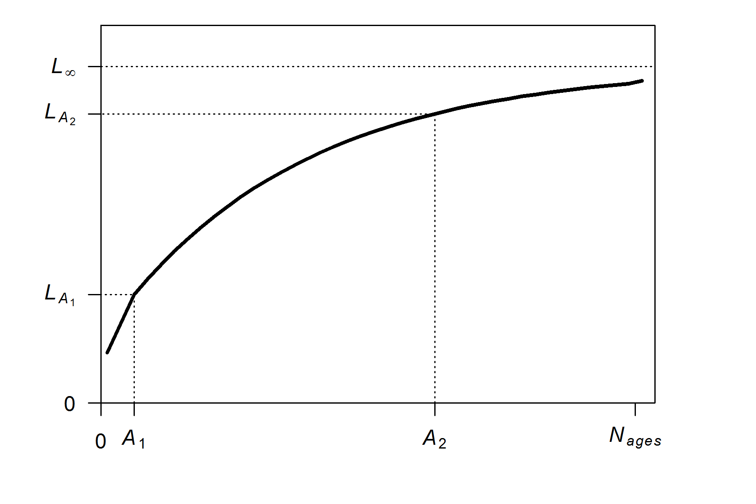
Parameterization of growth: mean length
Von Bertalanffy growth with 2 reference ages
source model: growth_illustration_offset2

Slide 6
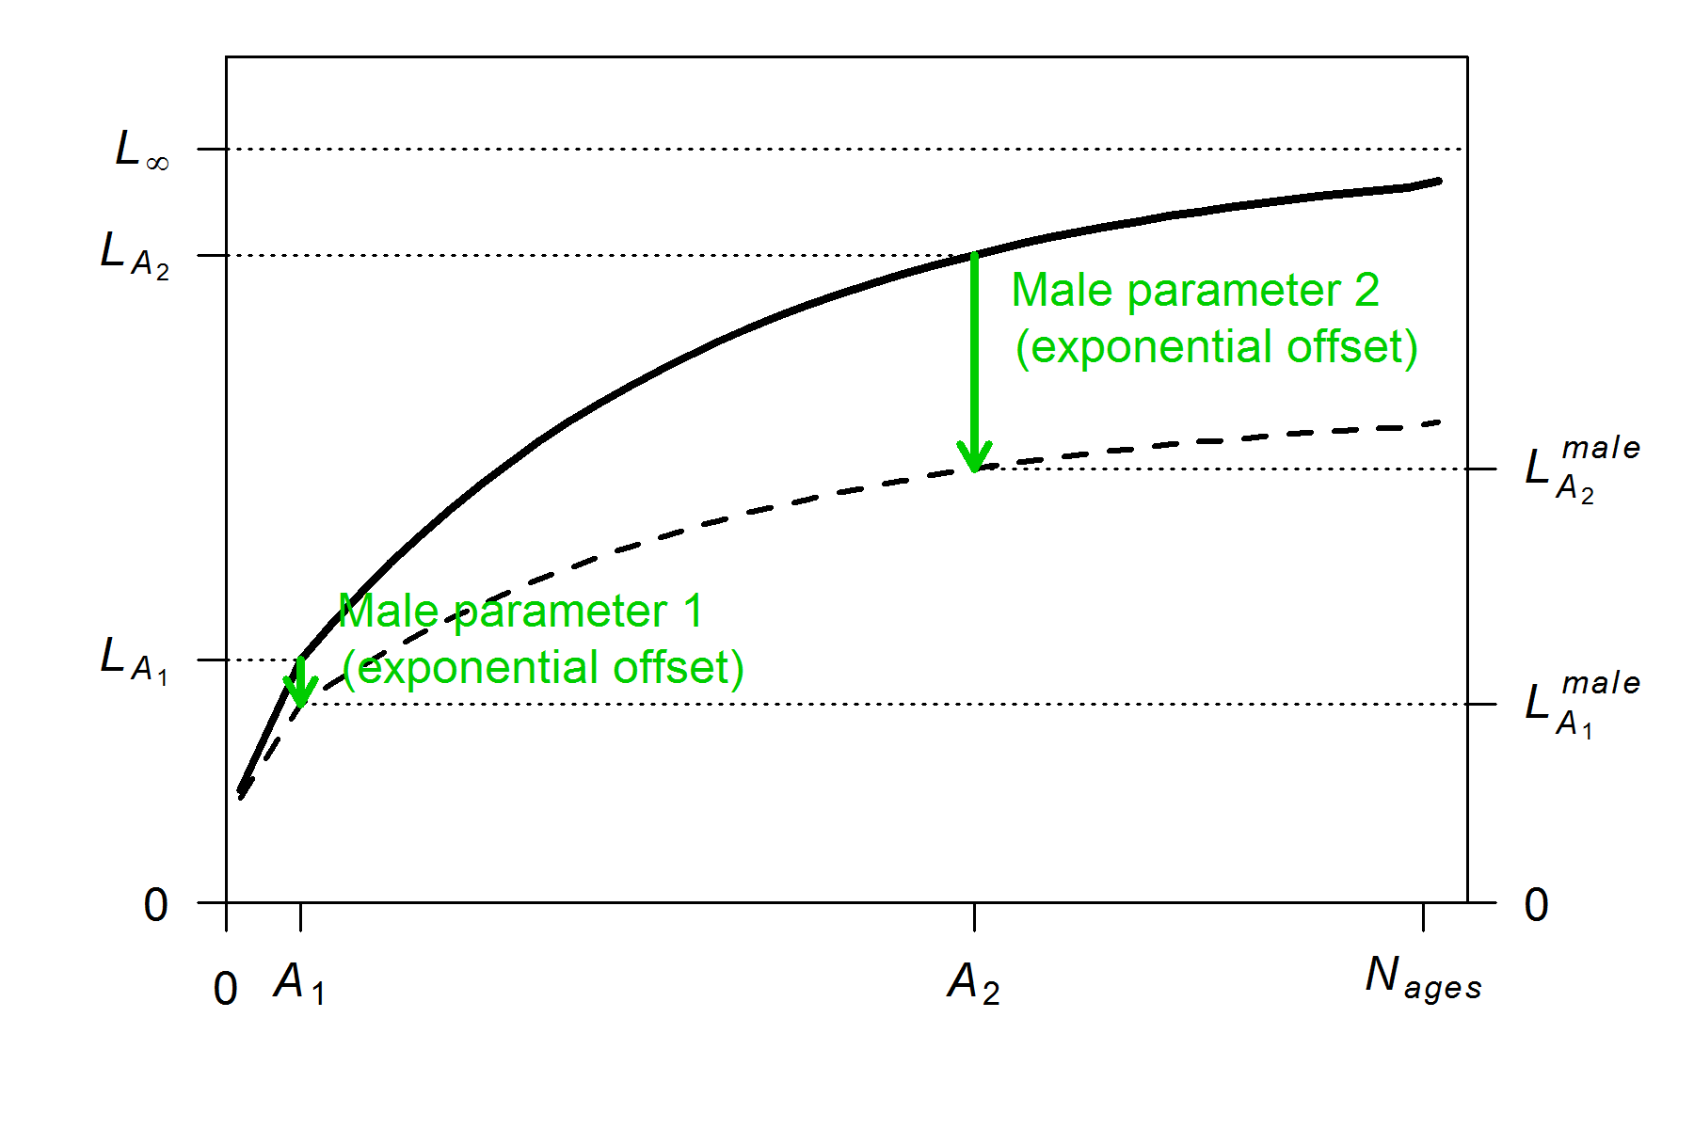
Parameterization of growth: mean length
Male growth can be separate parameters or exponential offsets
source model: growth_illustration_offset2

Slide 7
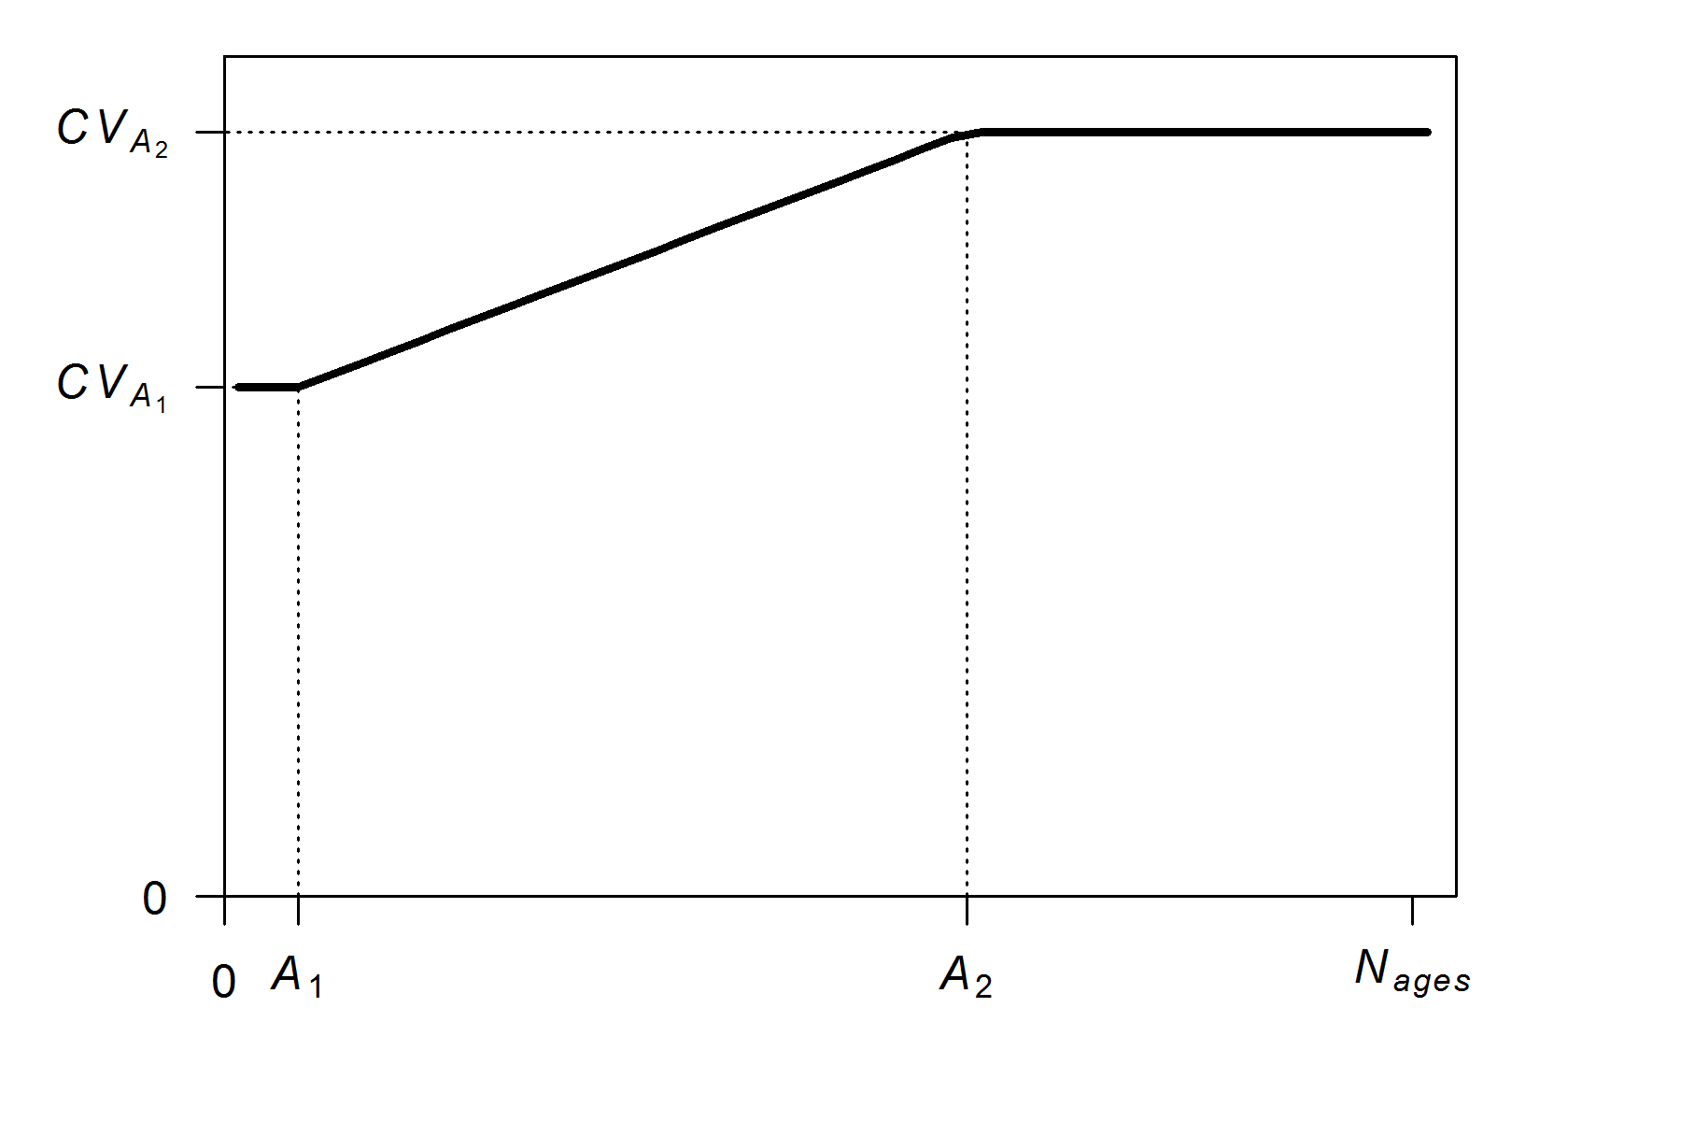
Parameterization of growth: length variability
Variability in length at age determined by 2-parameter “dogleg” function (with same reference ages as growth curve)
source model: growth_illustration_offset2

Slide 8
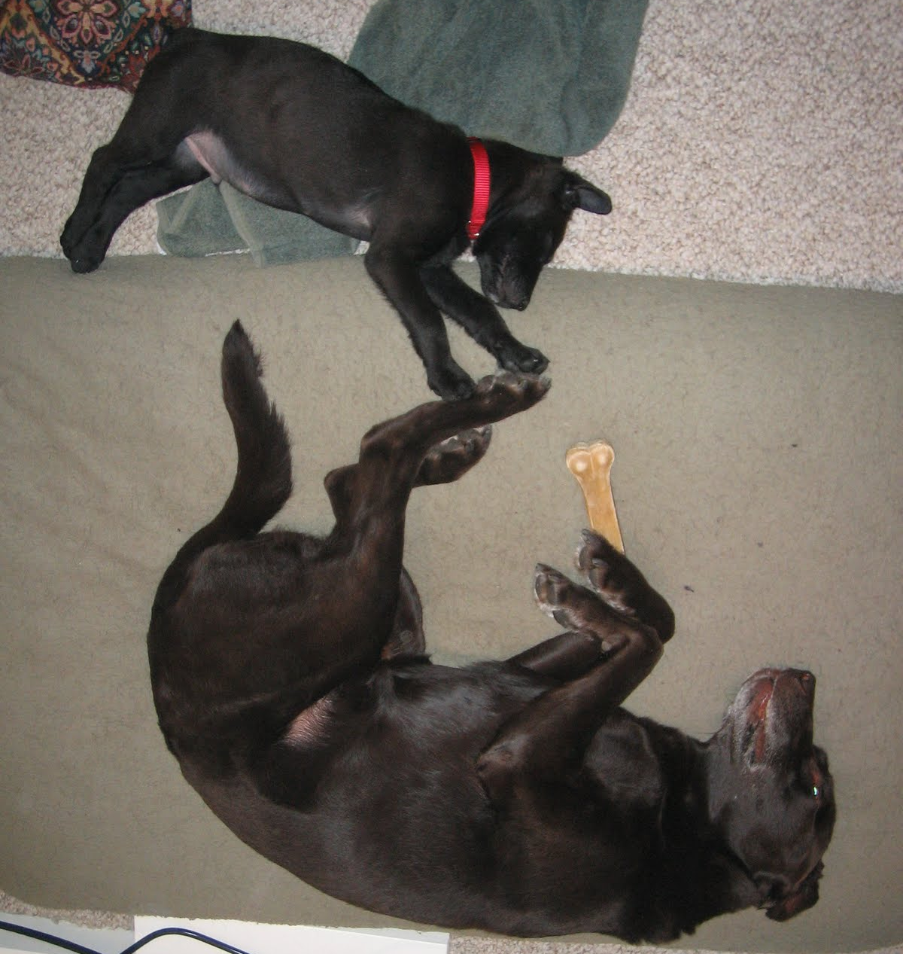
Parameterization of growth: length variability
Variability in length at age determined by 2-parameter “dogleg” function (with same reference ages as growth curve)
source model: growth_illustration_offset2

Slide 9
Parameterization of growth: length variability
CV options for variability:
1 #_CV_Growth_Pattern: 0 CV=f(LAA); 1 CV=F(A); 2 SD=F(LAA); 3 SD=F(A); 4 logSD=F(A)
Can be CV or SD of growth
Can be age or length
source model: growth_illustration_offset2

Slide 10
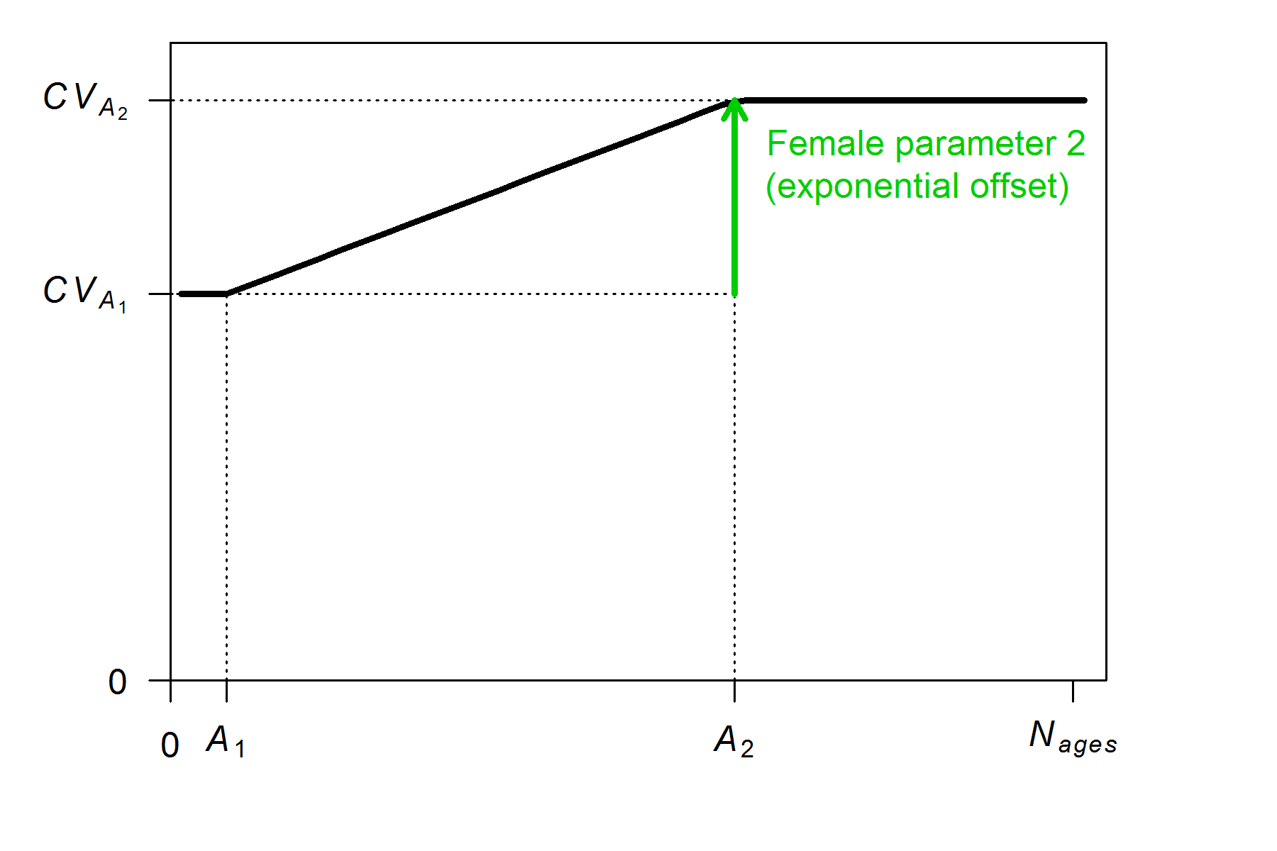
Parameterization of growth: length variability
Offset options for variability:
#_parameter_offset_approach (1=none, 2= M, G, CV_G as offset from female-GP1, 3=like SS2 V1.x)
source model: growth_illustration_offset3

Slide 11
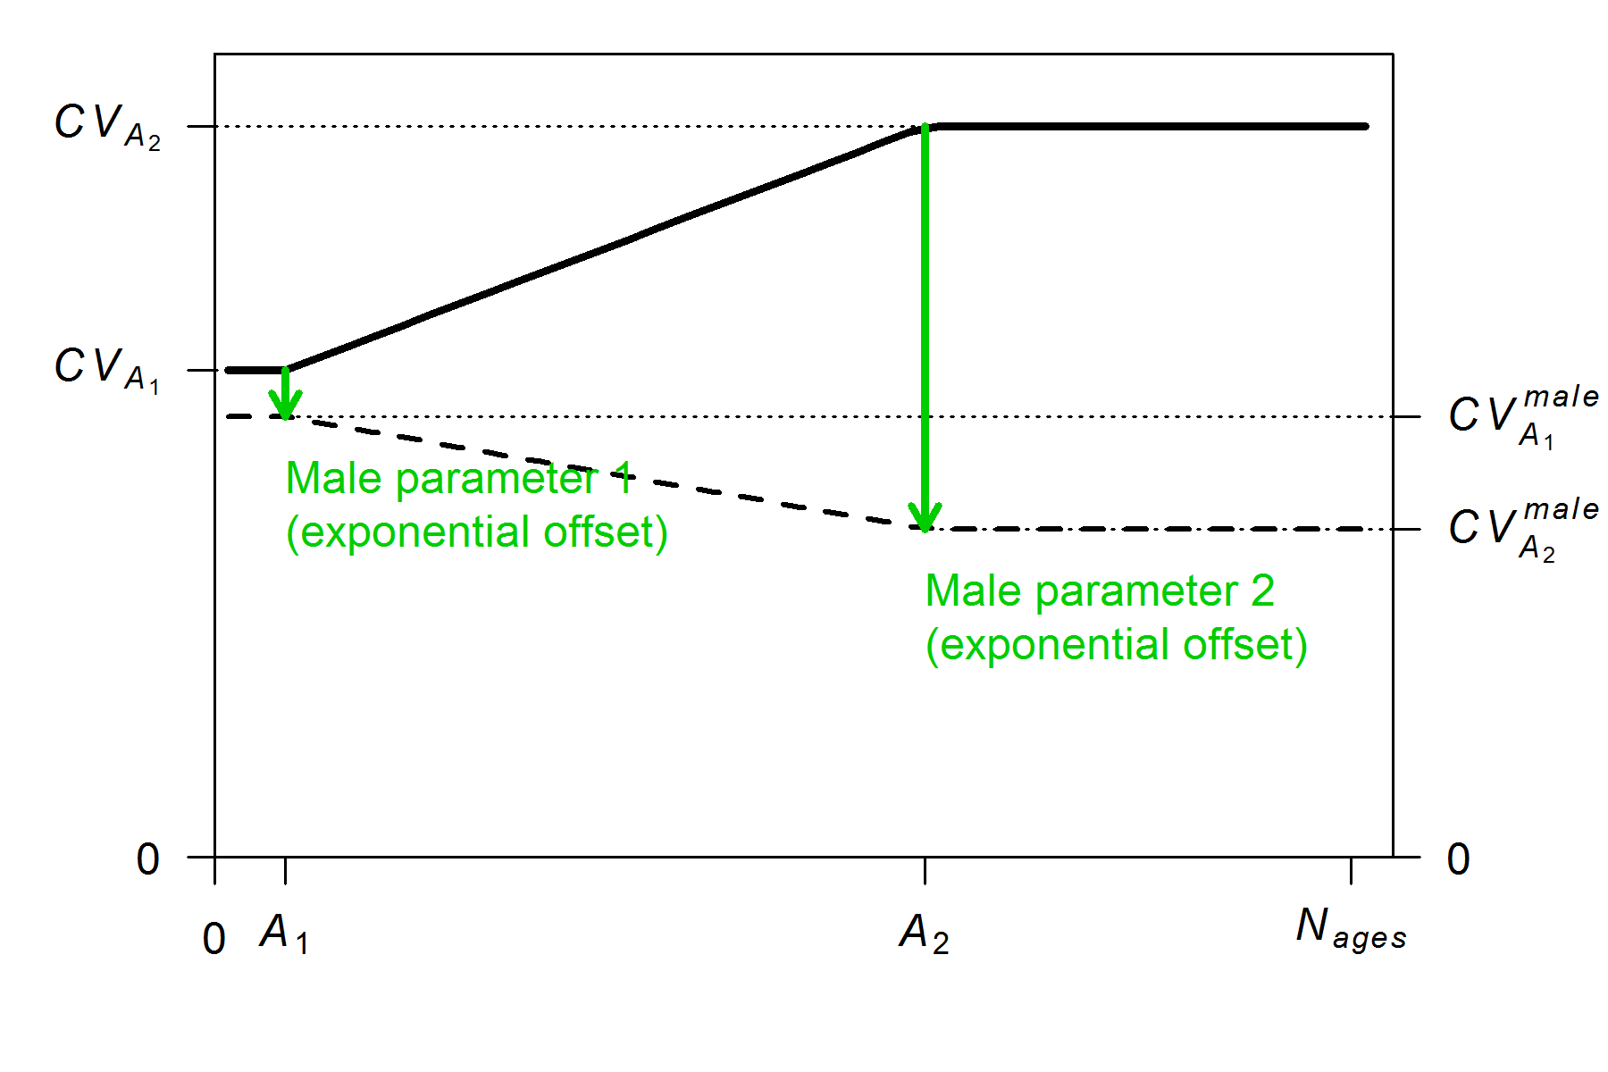
Parameterization of growth: length variability
Offset options for variability:
#_parameter_offset_approach (1=none, 2= M, G, CV_G as offset from female-GP1, 3=like SS2 V1.x)
source model: growth_illustration_offset2

Slide 12
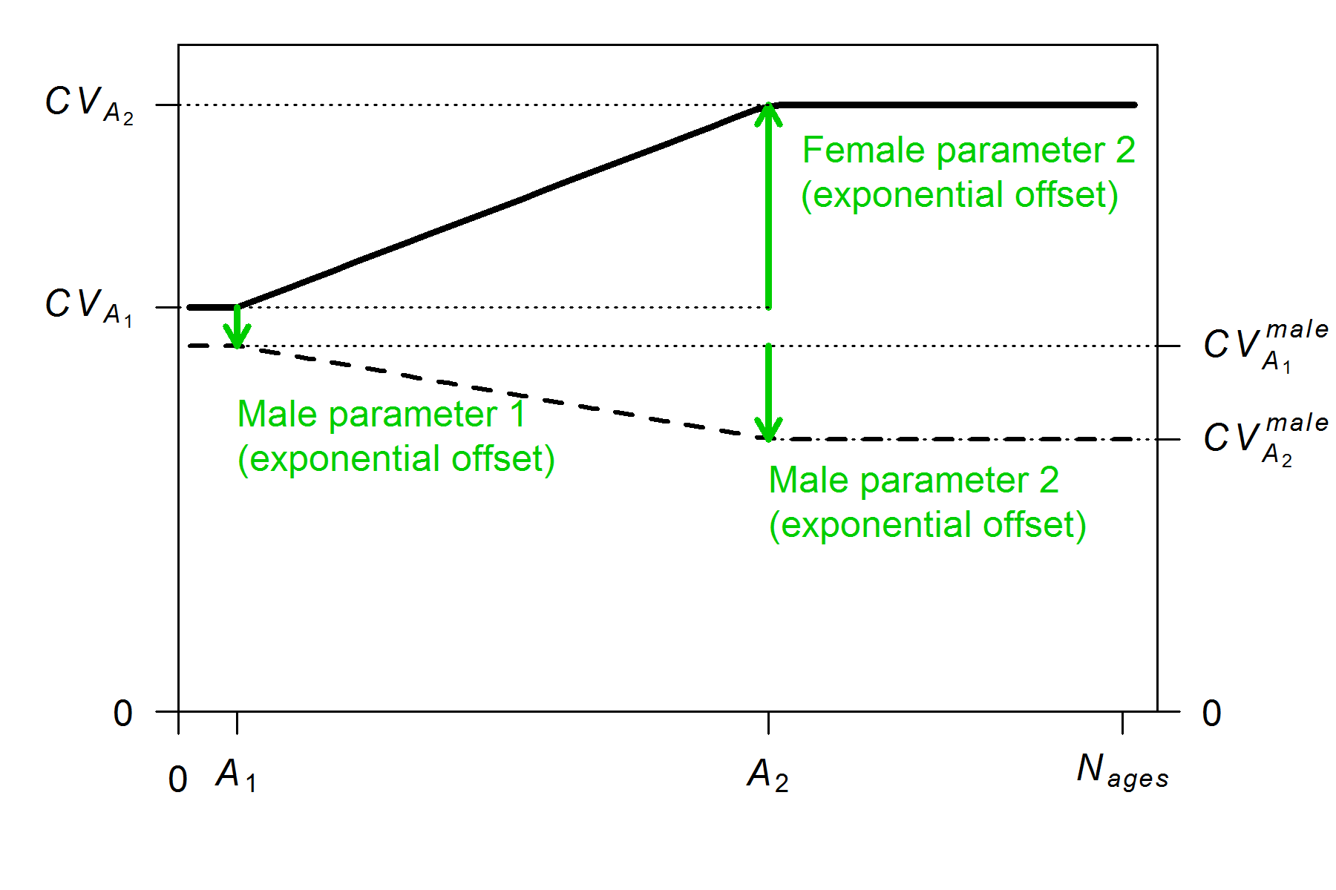
Parameterization of growth: length variability
Offset options for variability:
#_parameter_offset_approach (1=none, 2= M, G, CV_G as offset from female-GP1, 3=like SS2 V1.x)
source model: growth_illustration_offset3

Slide 13
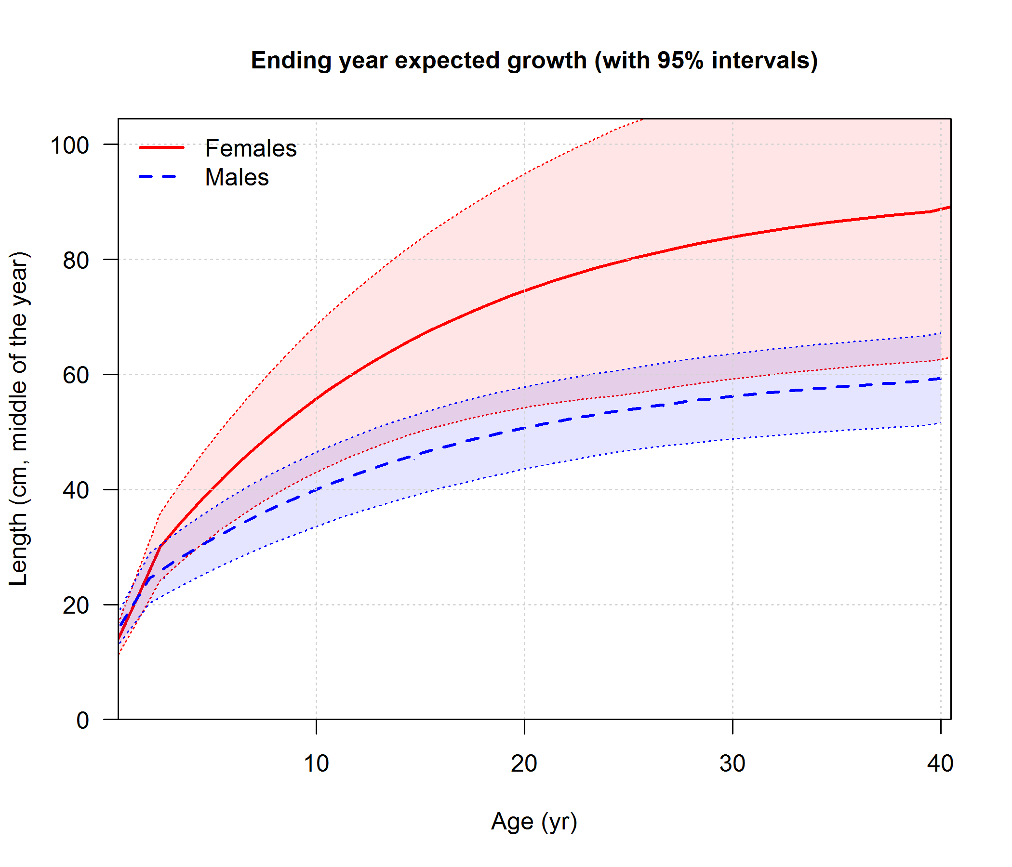
Parameterization of growth: summary
source model: growth_illustration_offset2

Slide 14
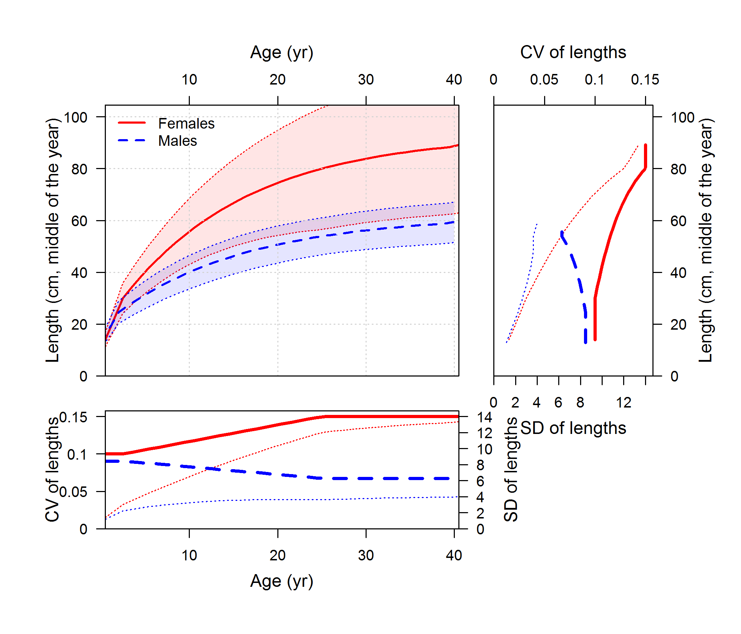
Parameterization of growth: summary
source model: growth_illustration_offset2

Slide 15
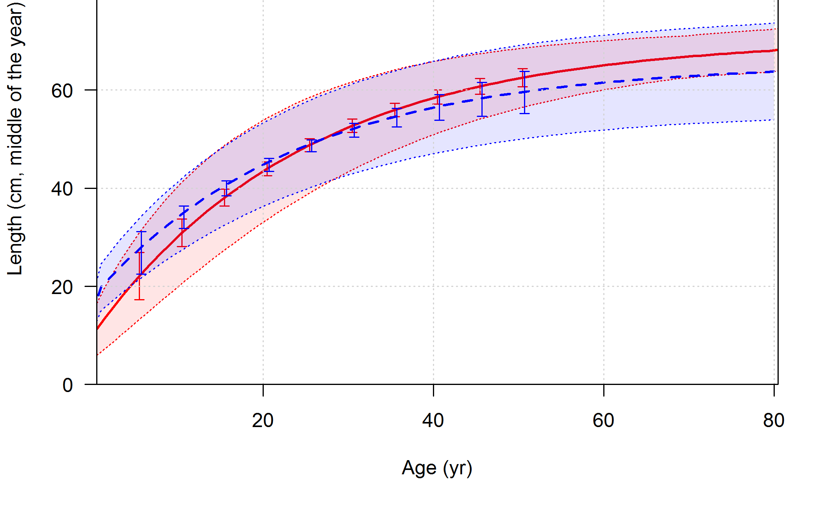
Parameterization of growth: uncertainty
1 # (0/1) read specs for more stddev reporting
1 1 -1 2 # selex type (flt), len=1/age=2, year, N selex bins (4 vals)
1 10 # Growth pattern, N growth ages (2 values)
1 -1 2 # NatAge_area(-1 for all), NatAge_yr, N Natages (3 values)
-1 1 # vector with selex std bin picks
5 10 15 20 25 30 35 40 45 50 # vector with growth std bin picks
-1 1 # vector with NatAge std bin picks
999 # end of control file
source model: rockfish_conditional_ages

Slide 16
Example models

Slide 17
Example models: overview
Models for illustrating parameterization (based on “simple”), not to be used for estimation:
growth_illustration_offset2
growth_illustration_offset3
Model for illustrating empirical weight-at-age approach:
hake2014_simplified
Models for illustrating conditional and marginal age compositions
rockfish_conditional_ages
rockfish_marginal_ages
small_pelagic_A1

Slide 18
Example models: data types
All length and age observations may be associated with (0) combined sexes, (1) females, (2) males, (3) females & males (but not combined)
Also can be associated with (0) whole catch (discard + retained) (1) discarded catch (2) retained catch

Slide 19
Example models: data types
Length compositions
Age compositions
Can represent all observed fish (Lbin_lo = Lbin_hi = -1), or
Can be conditioned on a range of lengths
Meaning of Lbin_lo and Lbin_hi have based on input #_Lbin_method: 1=poplenbins; 2=datalenbins; 3=lengths
Lbin_lo = Lbin_hi references a single length bin
Mean length- or weight-at-age data
Based on observed age, which may included ageing error

Slide 20
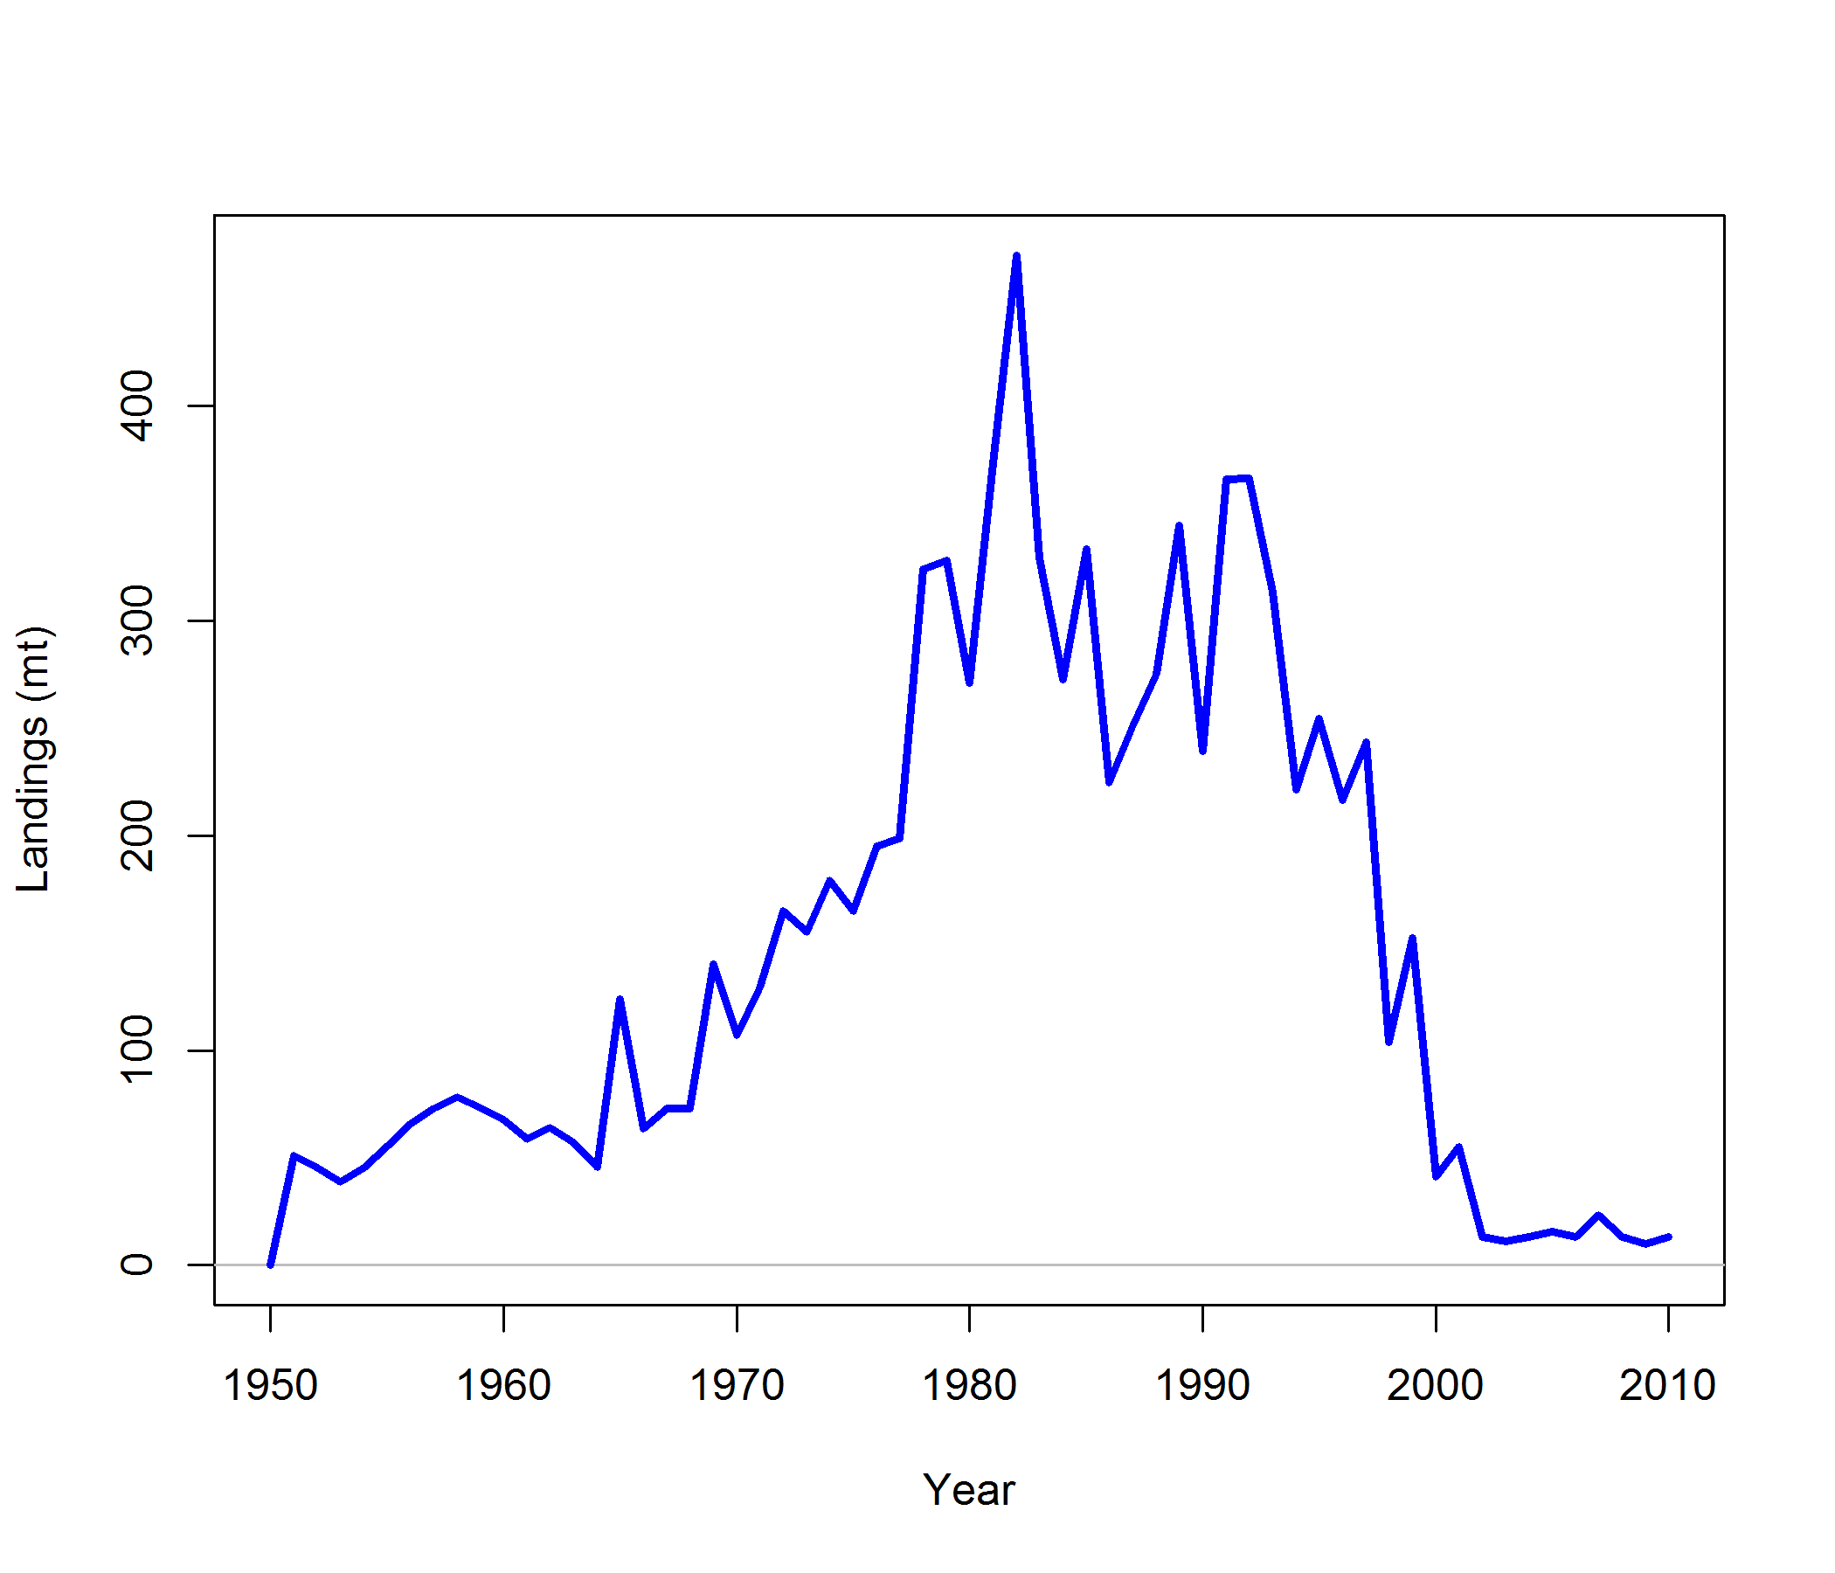
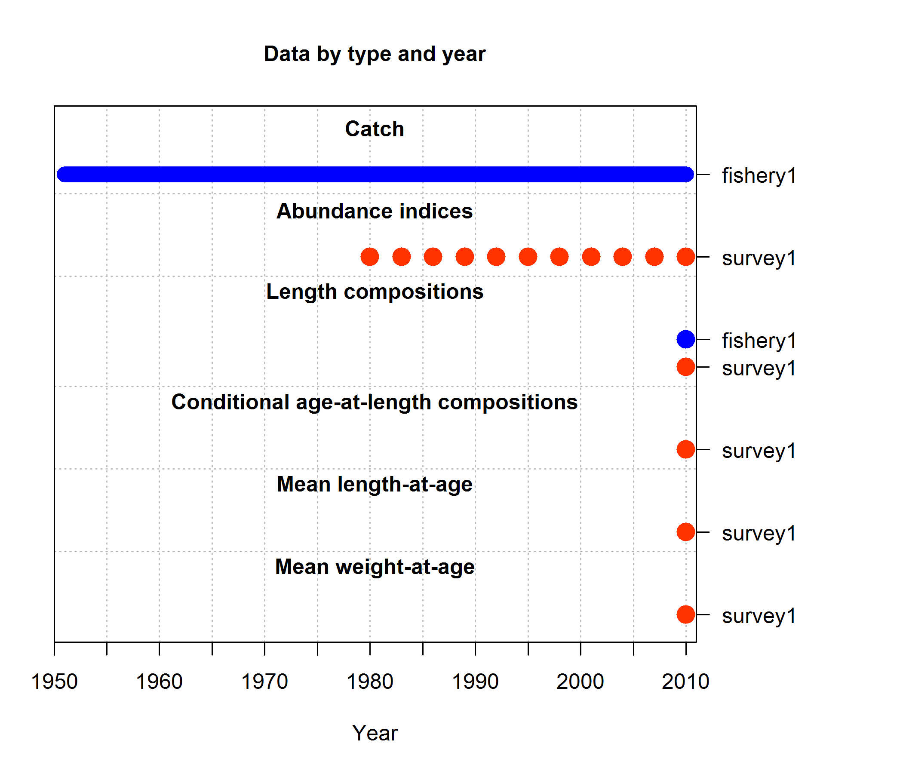
Example model: rockfish
Biology and catch history based on west coast assessment of yelloweye rockfish (also used in Taylor & Methot, 2013)
Simulated data:
triennial abundance index: 1980–2010, lengths and ages in 2010
24 Parameters estimated:
10 growth parameters (L₁, L₂, k, CV₁, CV₂ for both females and males)
10 selectivity parameters (5 param. double-normal x 2 fleets)
M (males & females), equilibrium recruitment log(R₀), steepness h,

Slide 21
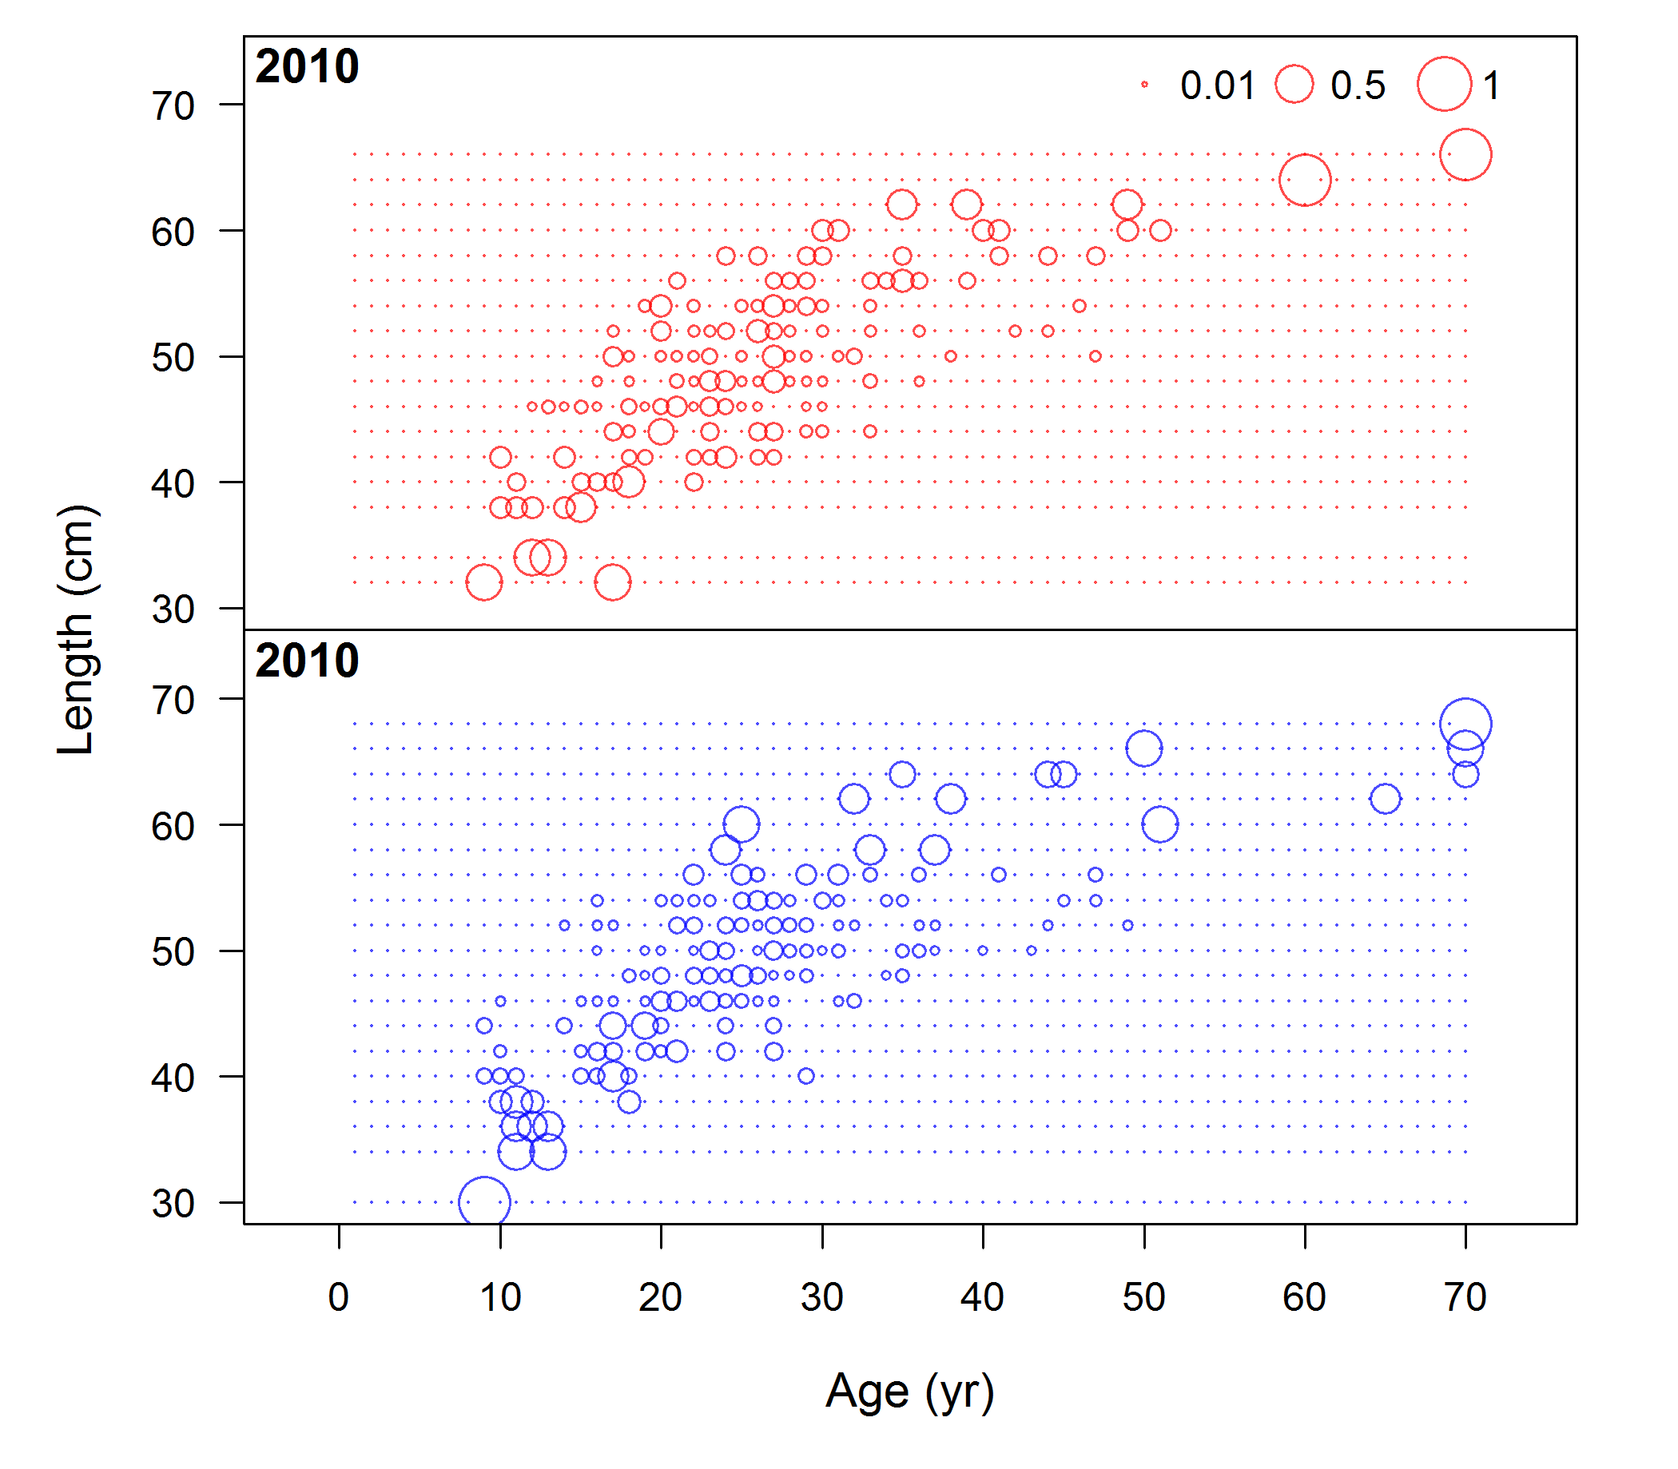
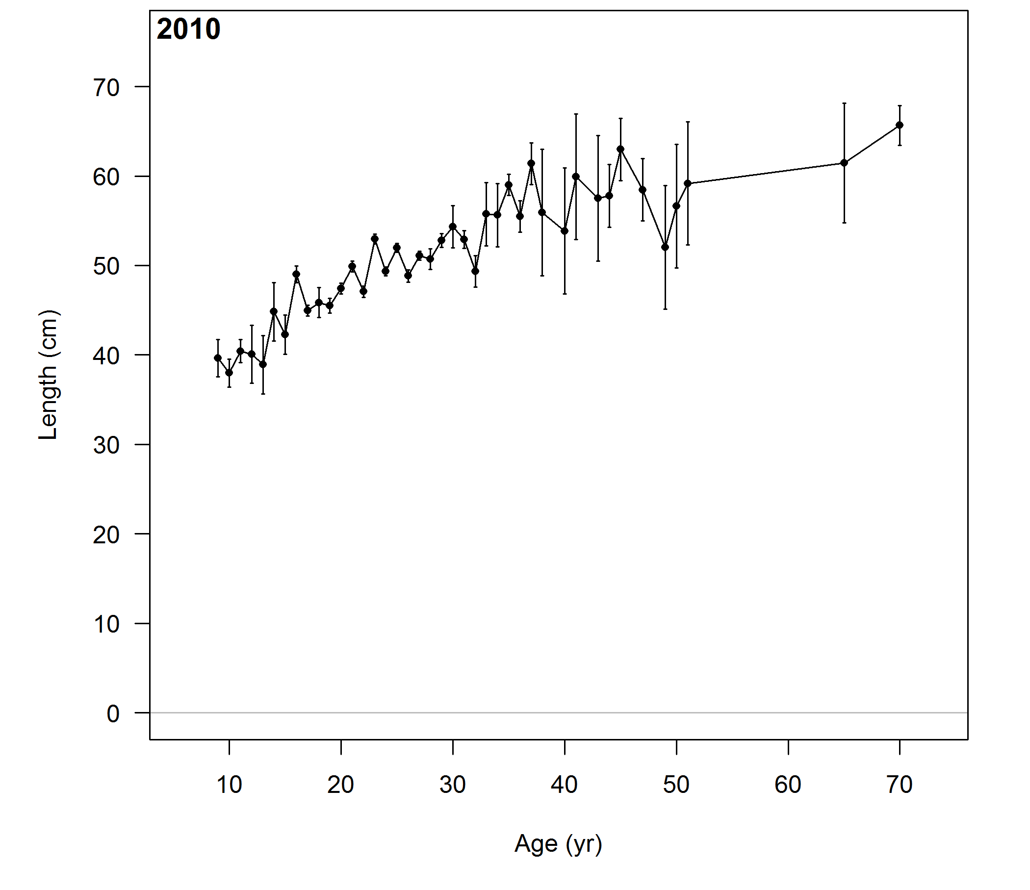
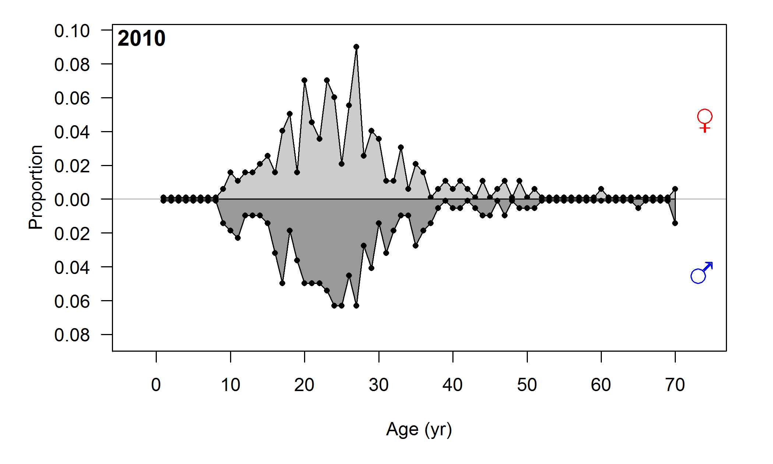
Example model: rockfish simulated data
mean length-at-age & marginal ages
conditional

Slide 22
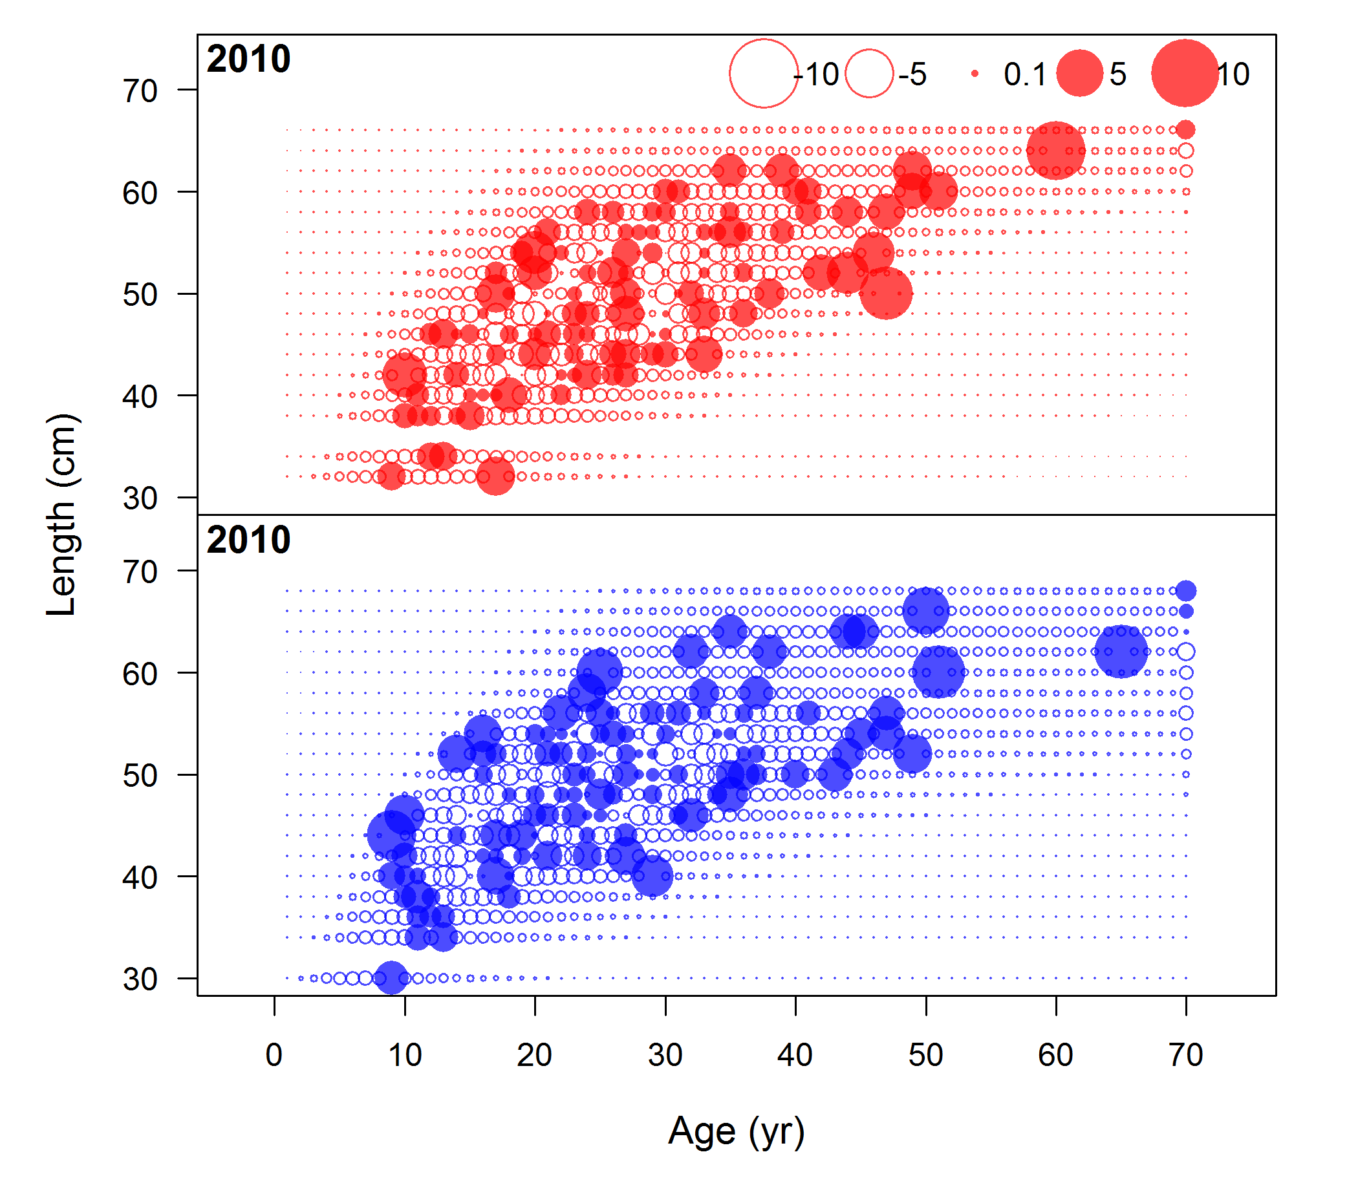
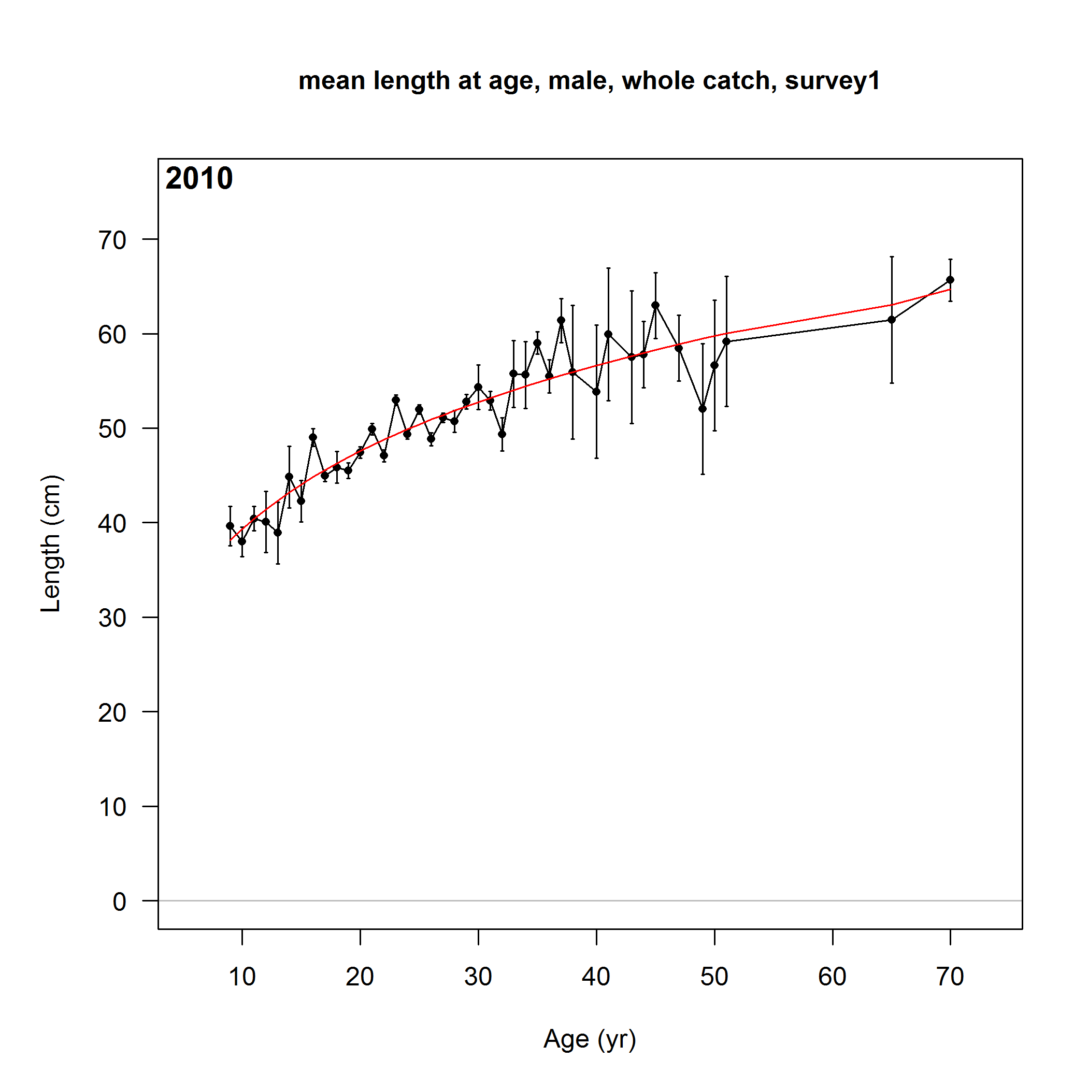
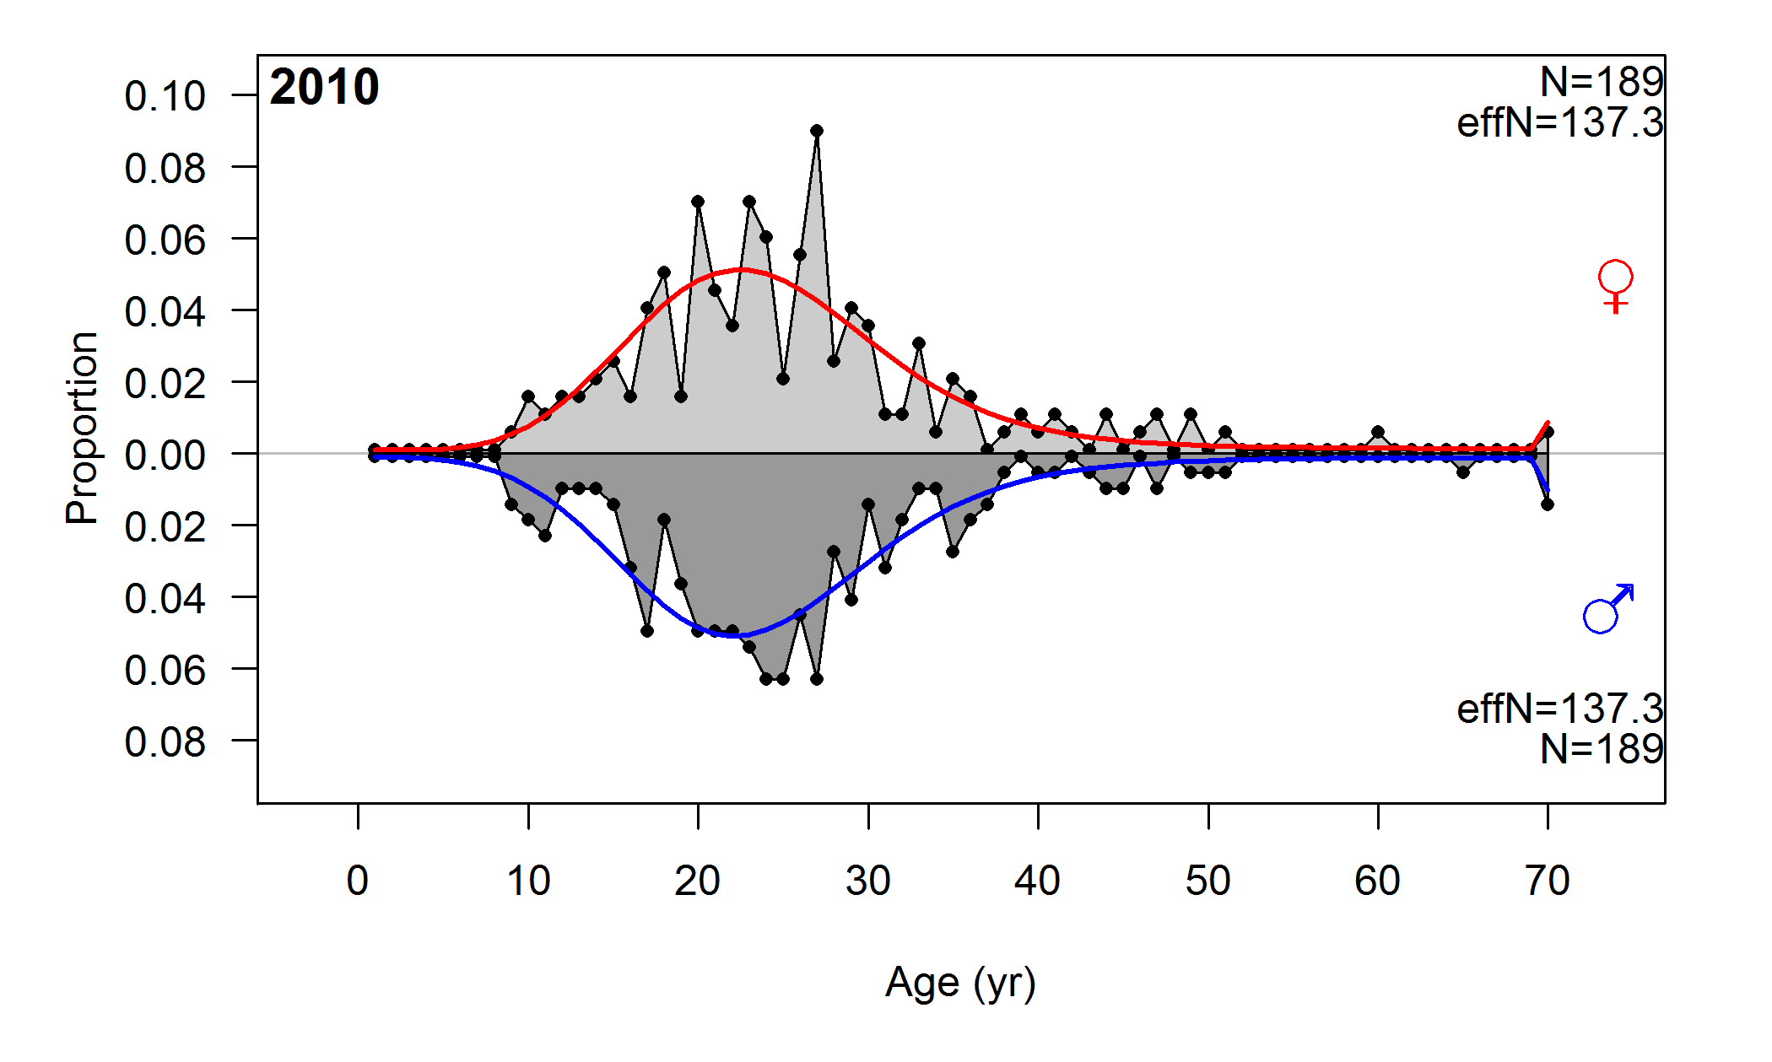
Example model: rockfish fits to data
mean length-at-age & marginal ages
conditional

Slide 23
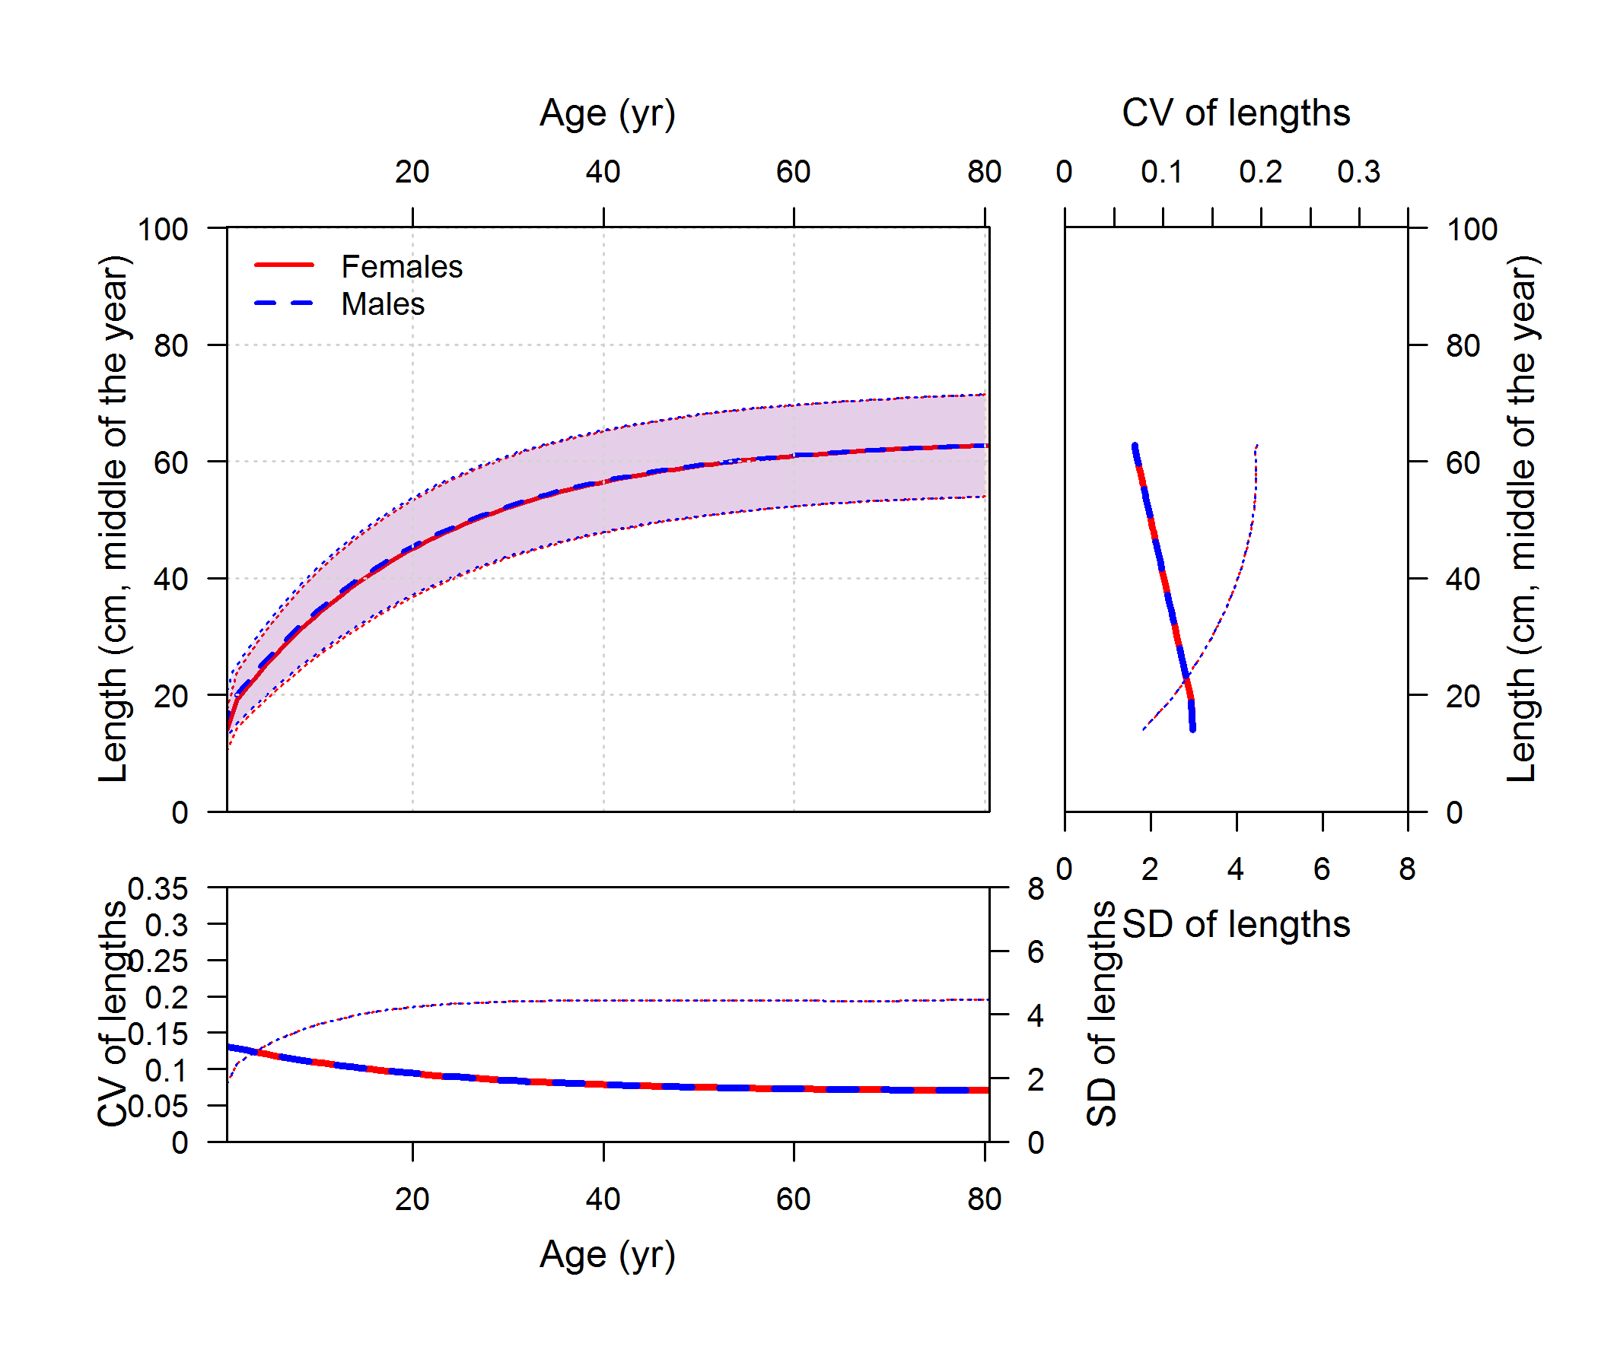
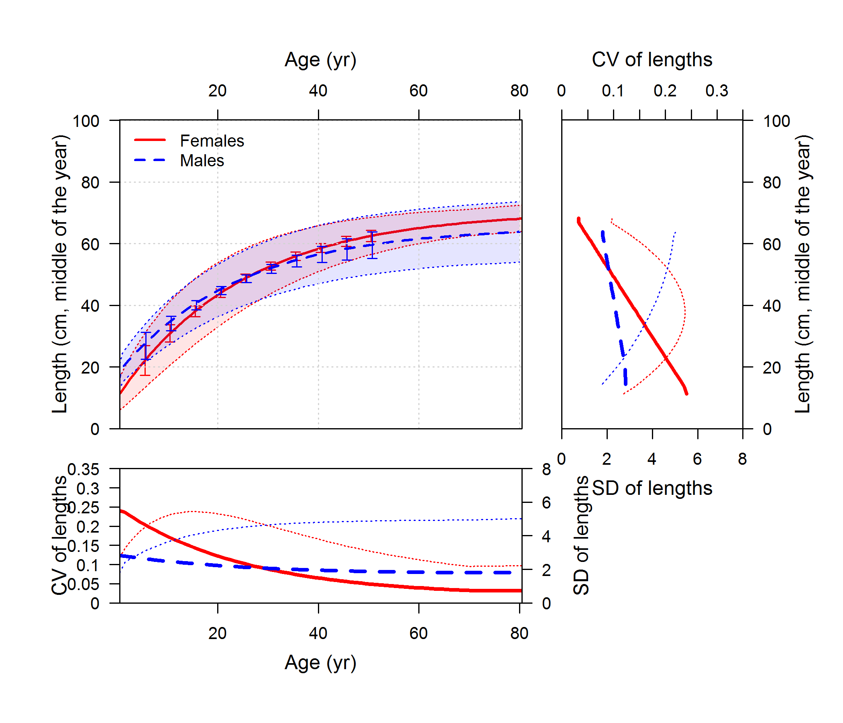

Example model: rockfish simulated growth
mean length-at-age & marginal ages
conditional
source model: extra_stuff/rockfish_simulation

Slide 24
Example model: rockfish estimated growth
mean length-at-age & marginal ages
conditional
Conclusion: similar fits, reasonable estimates of both growth curve and variability in growth
source model: rockfish_conditional_ages, rockfish_marginal_ages

Slide 25
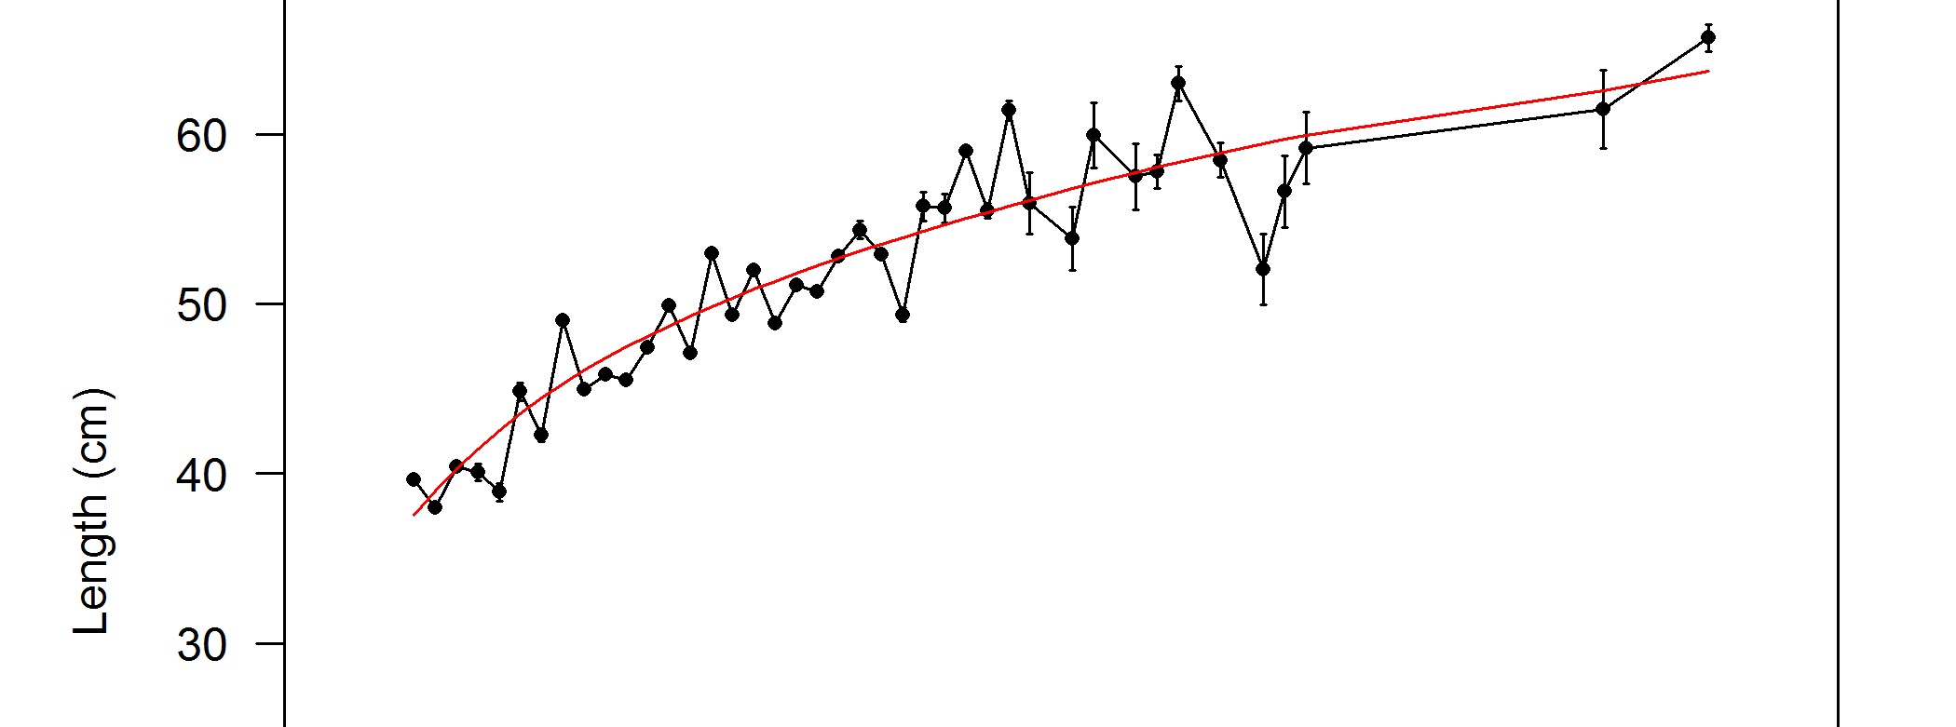
Example model: rockfish
Hypothesis:
Variability in mean lengths provides information about variability among fish
Test:
Multiply sample sizes by 10 and run models again
true sample size
N×10 sample size

Slide 26
Example model: rockfish simulated growth
mean length-at-age & marginal ages
conditional
source model: extra_stuff/rockfish_simulation

Slide 27
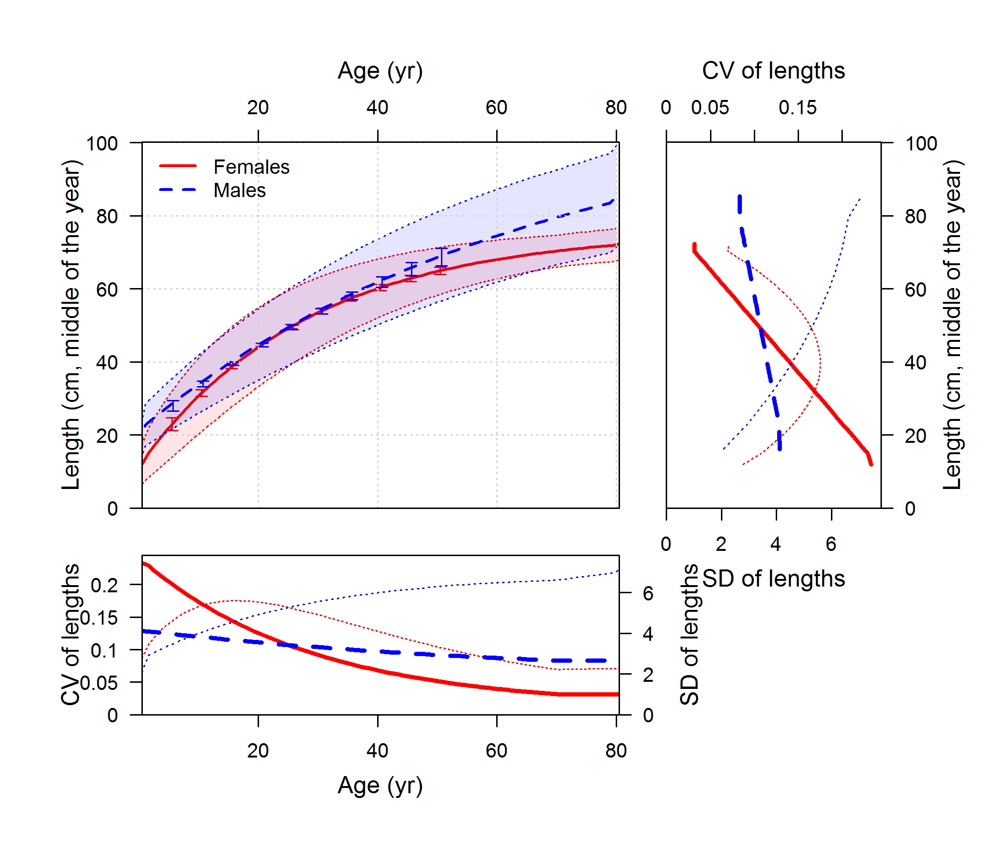
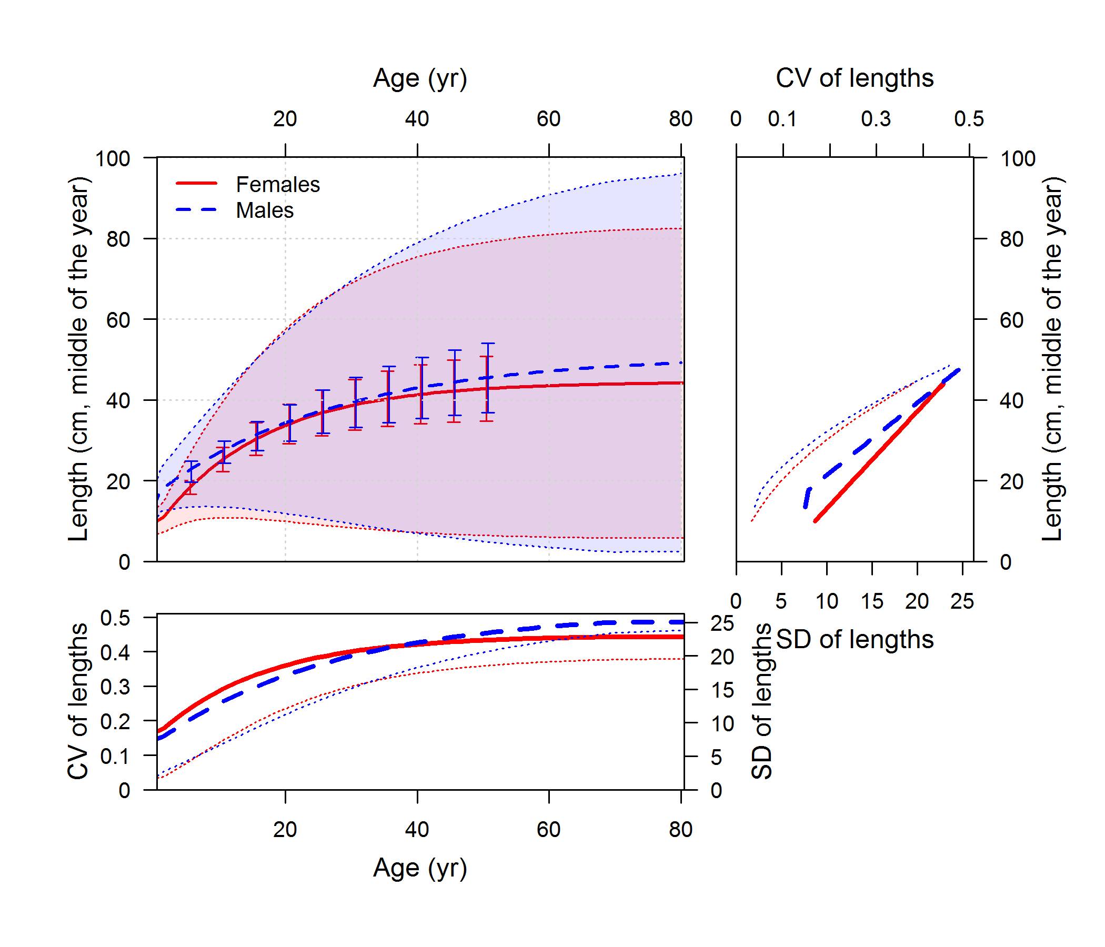
Example model: rockfish testing ages N×10
mean length-at-age & marginal ages
conditional
Conclusion: overdispersion in data caused bad estimate of variability in growth for marginal age model
source model: extra_stuff/rockfish_conditional_ages_highN, extra_stuff/rockfish_marginal_ages_highN

Slide 28
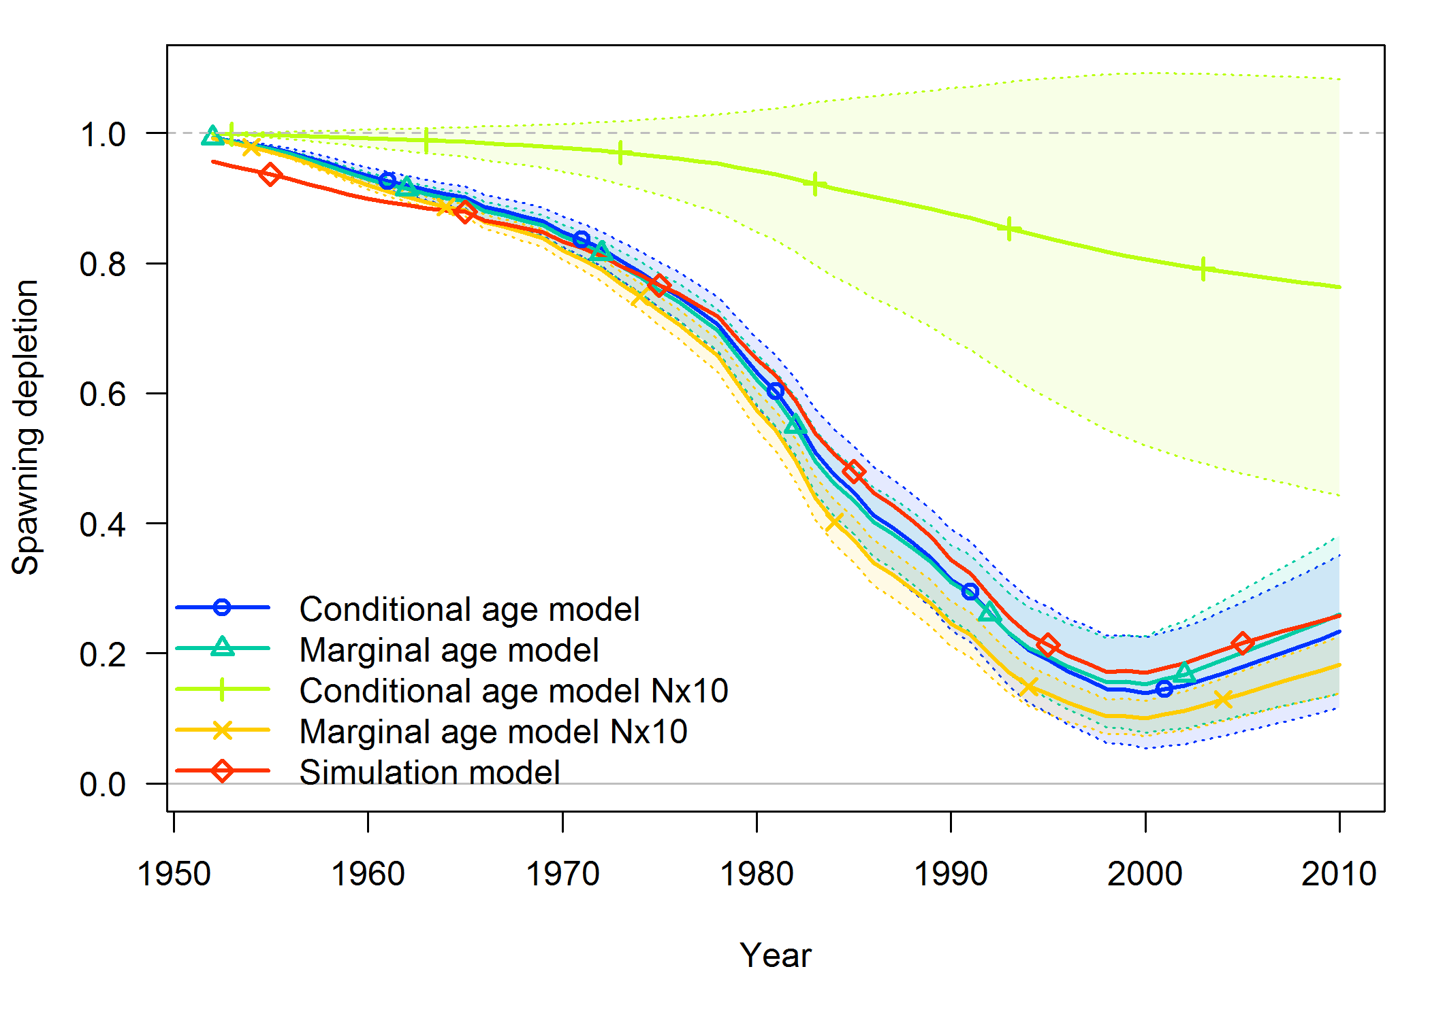
Example model: rockfish testing ages N×10
Ironic addendum: overdispersed data messed up stock status estimates for conditional model, not marginal model

Slide 29
Example model: rockfish testing ages N×10
Ironic addendum: overdispersed data messed up stock status estimates for conditional model, not marginal model

Slide 30
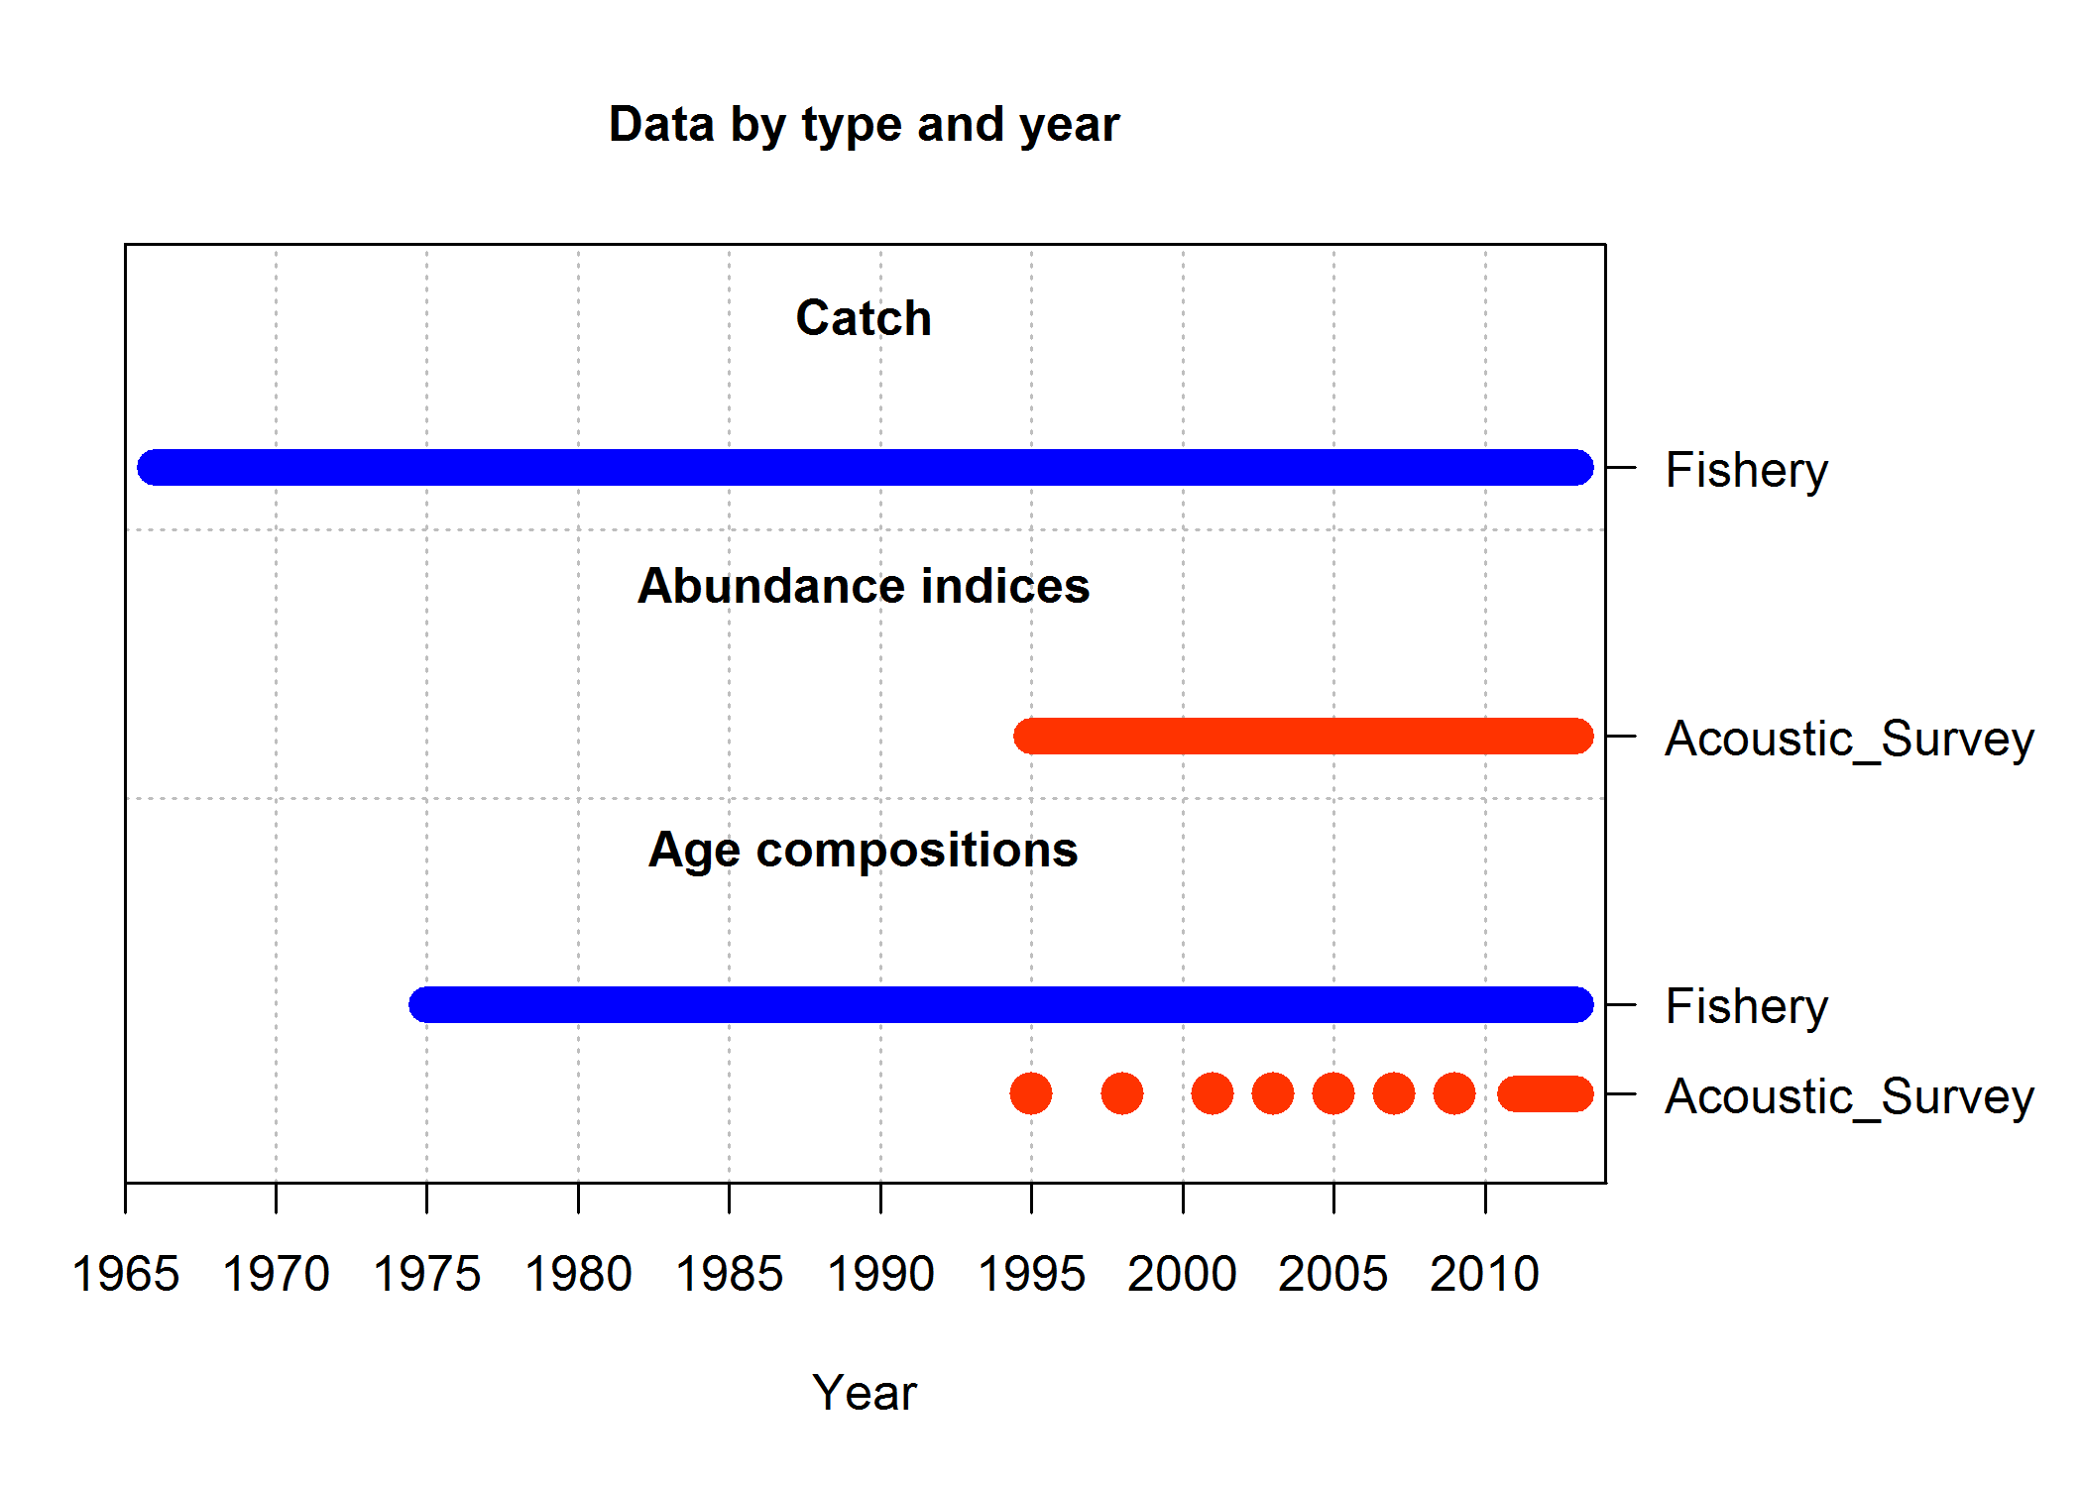
Example model: hake
Hake stock assessment for 2014 with 2 changes:
Cohort-specific ageing error removed
Time-varying non-parametric selectivity replaced with logistic
Data:
Age comps for many fishery years and fewer survey years
Index of abundance
Empirical weight-at-age matrix (not really data)
79 Parameters estimated:
0 growth parameters
4 selectivity parameters (2 param. logistic x 2 fleets)
71 recruitment deviations
M (sexes are combined), equilibrium recruitment log(R₀), steepness (h),
source model: hake2014_simplified

Slide 31
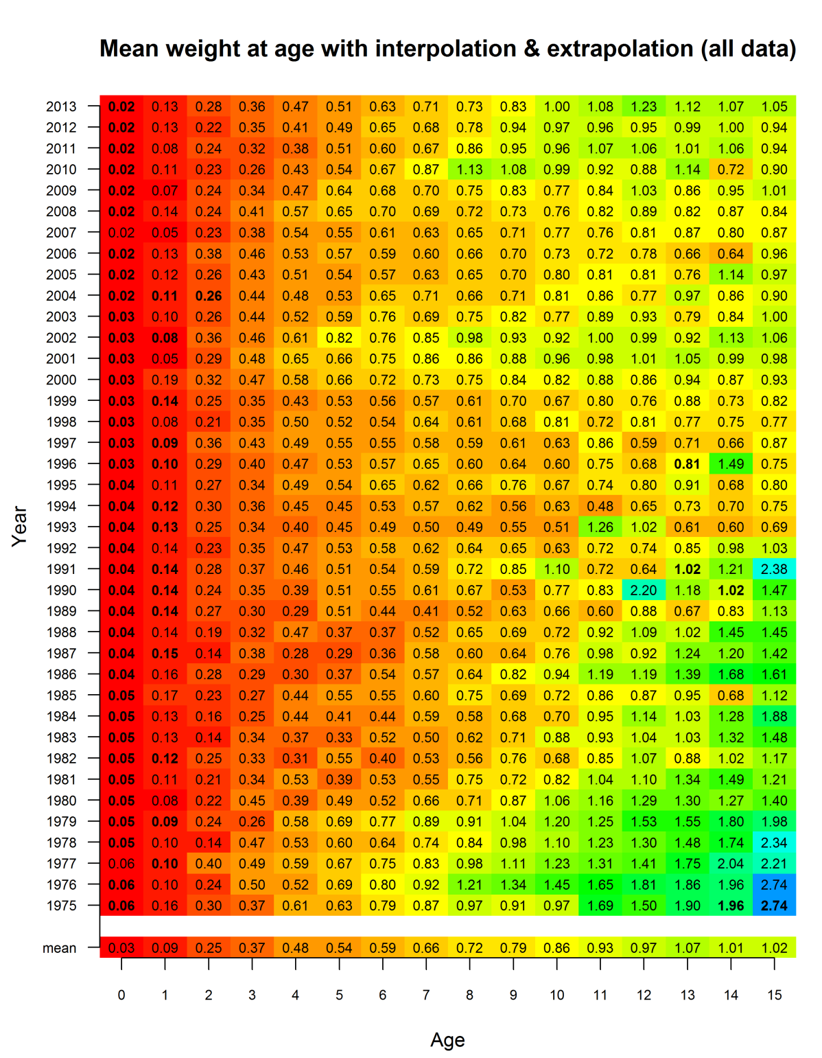
Example model: hake, weight at age
Matrix of weights
includes interpolations and extrapolations
early years assumed equal to mean
ages 15+ assumed constant
More exciting info 8am Friday morning
source model: hake2014_simplified

Slide 32
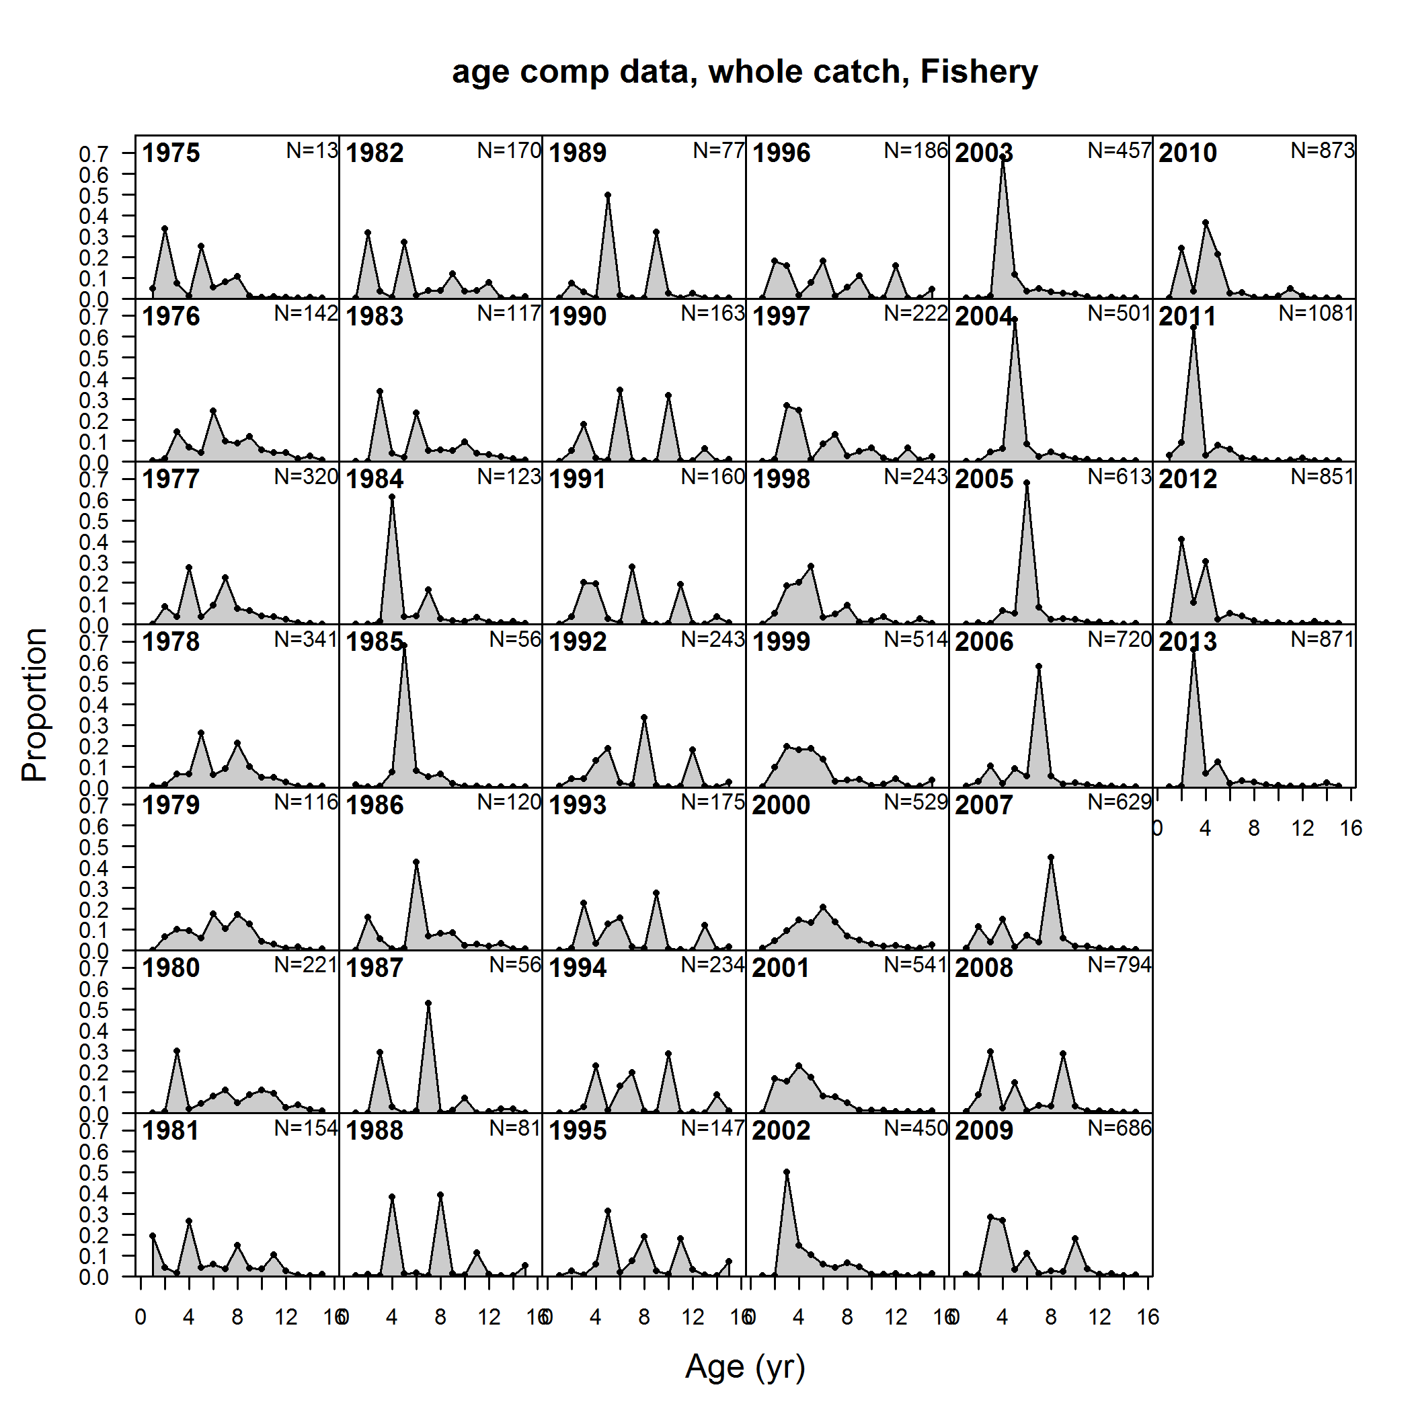
Example model: hake, age comps
source model: hake2014_simplified

Slide 33
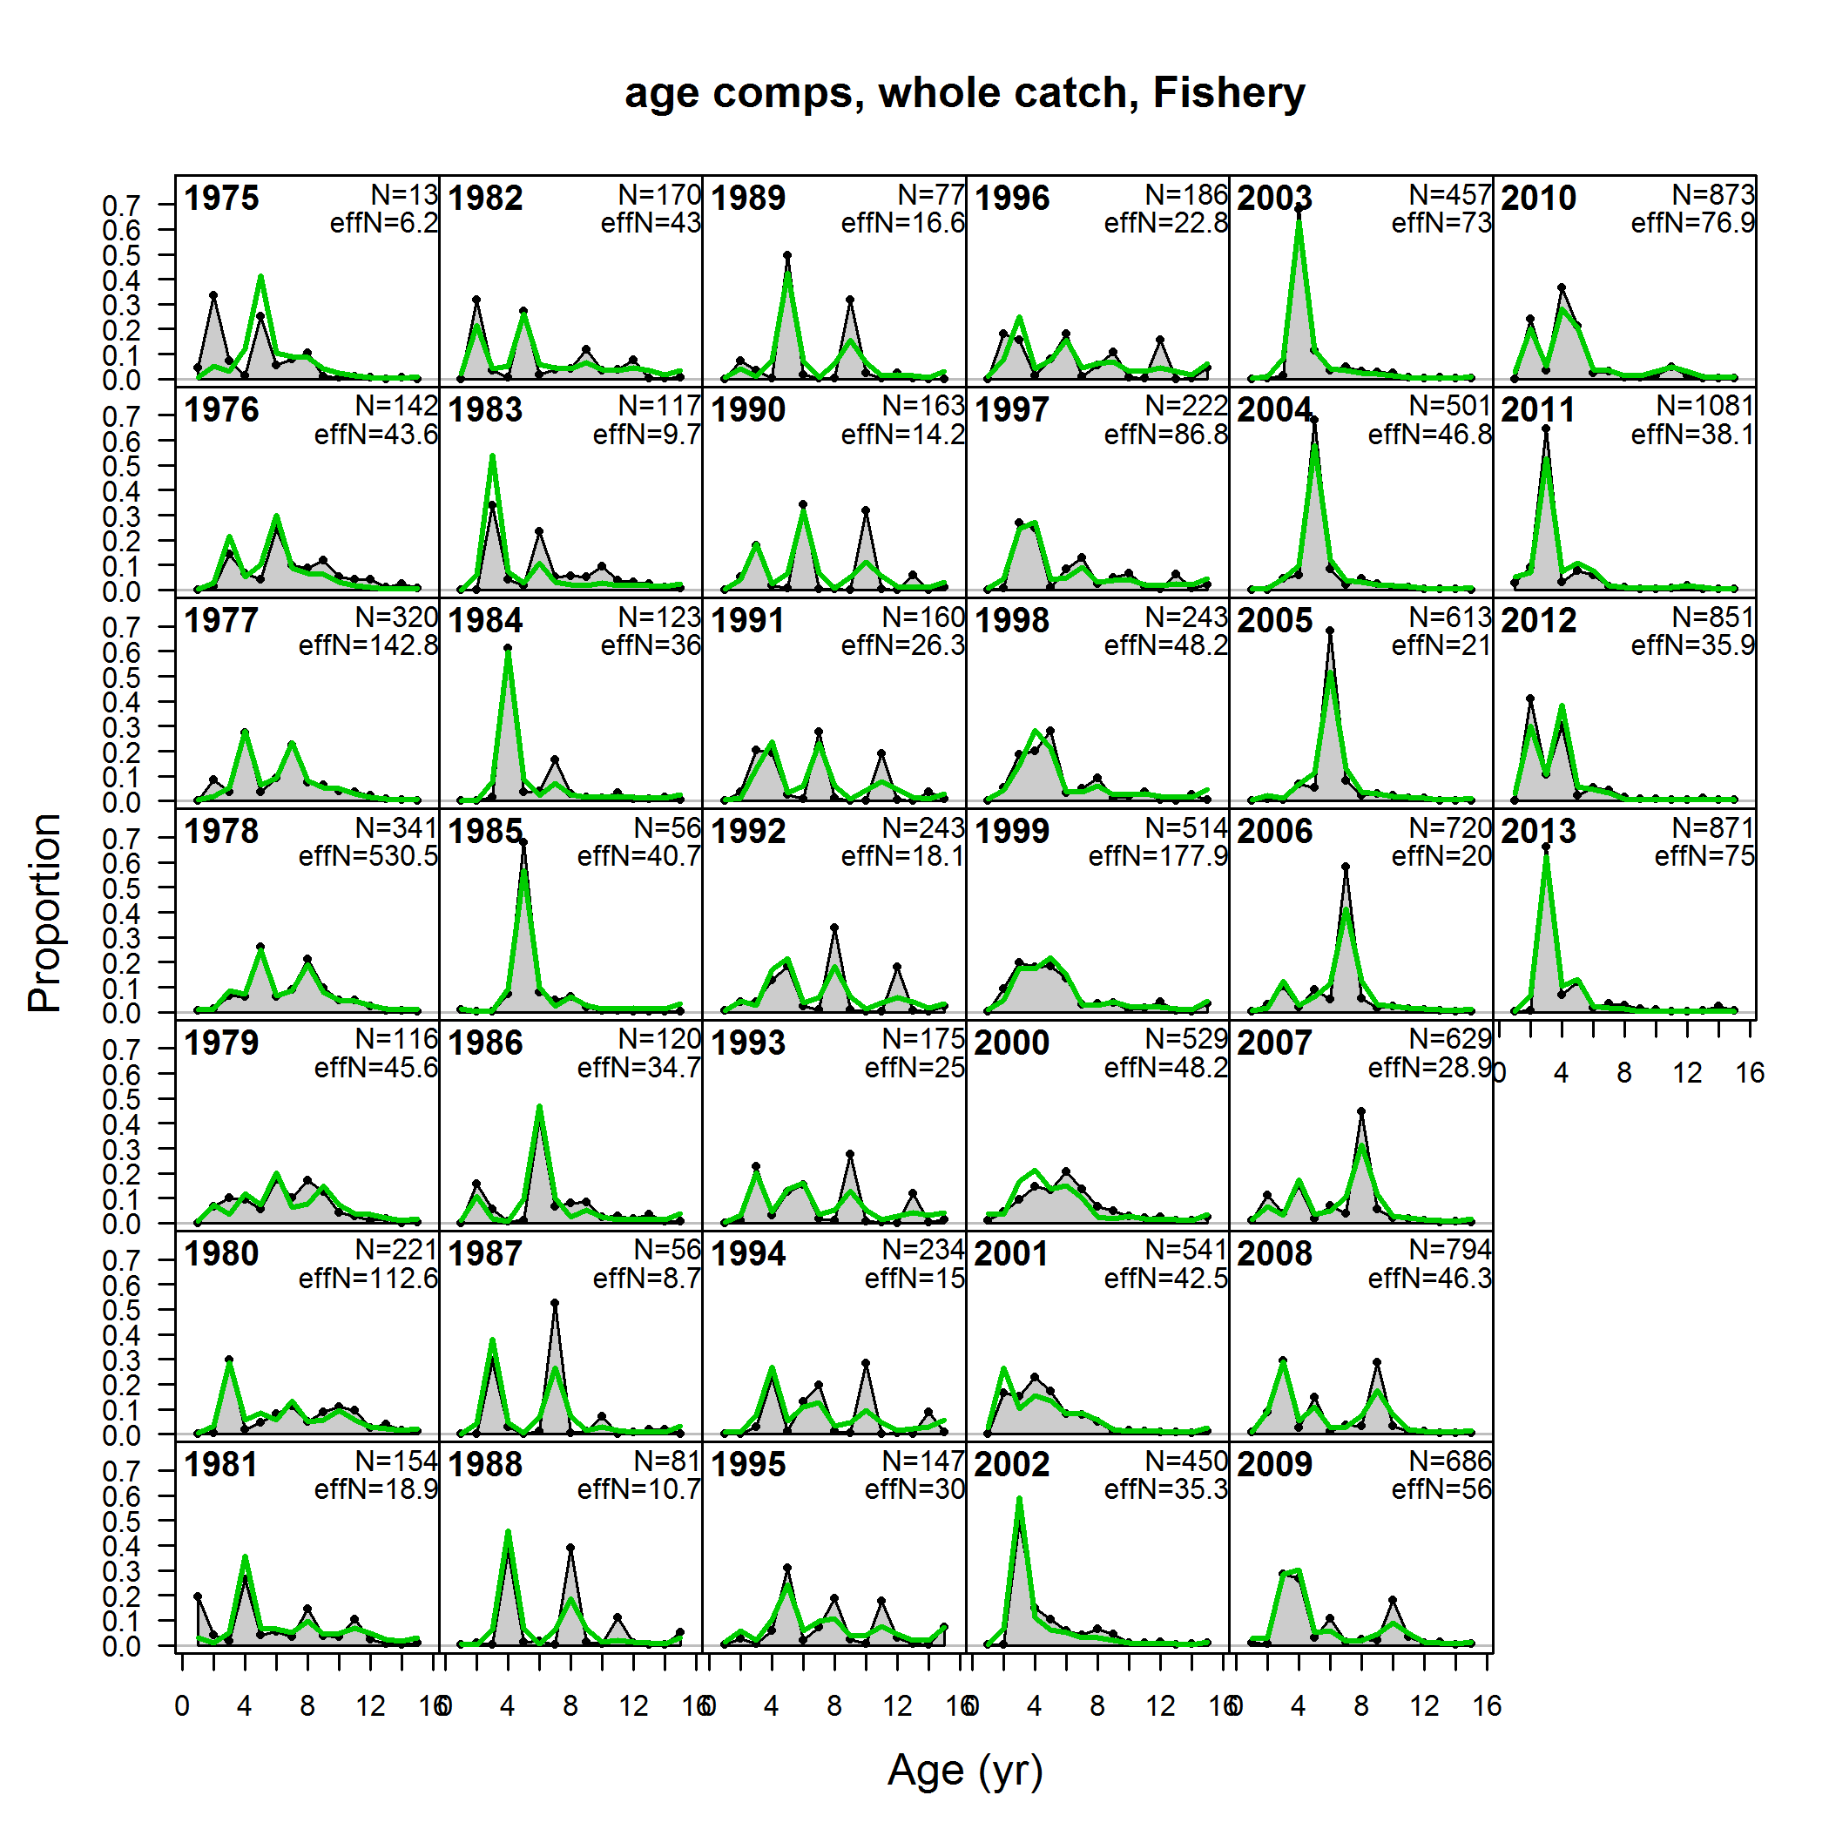
Example model: hake, age comps with fit
Informative age data = weight used to convert total catch to numbers at age removed
source model: hake2014_simplified

Slide 34
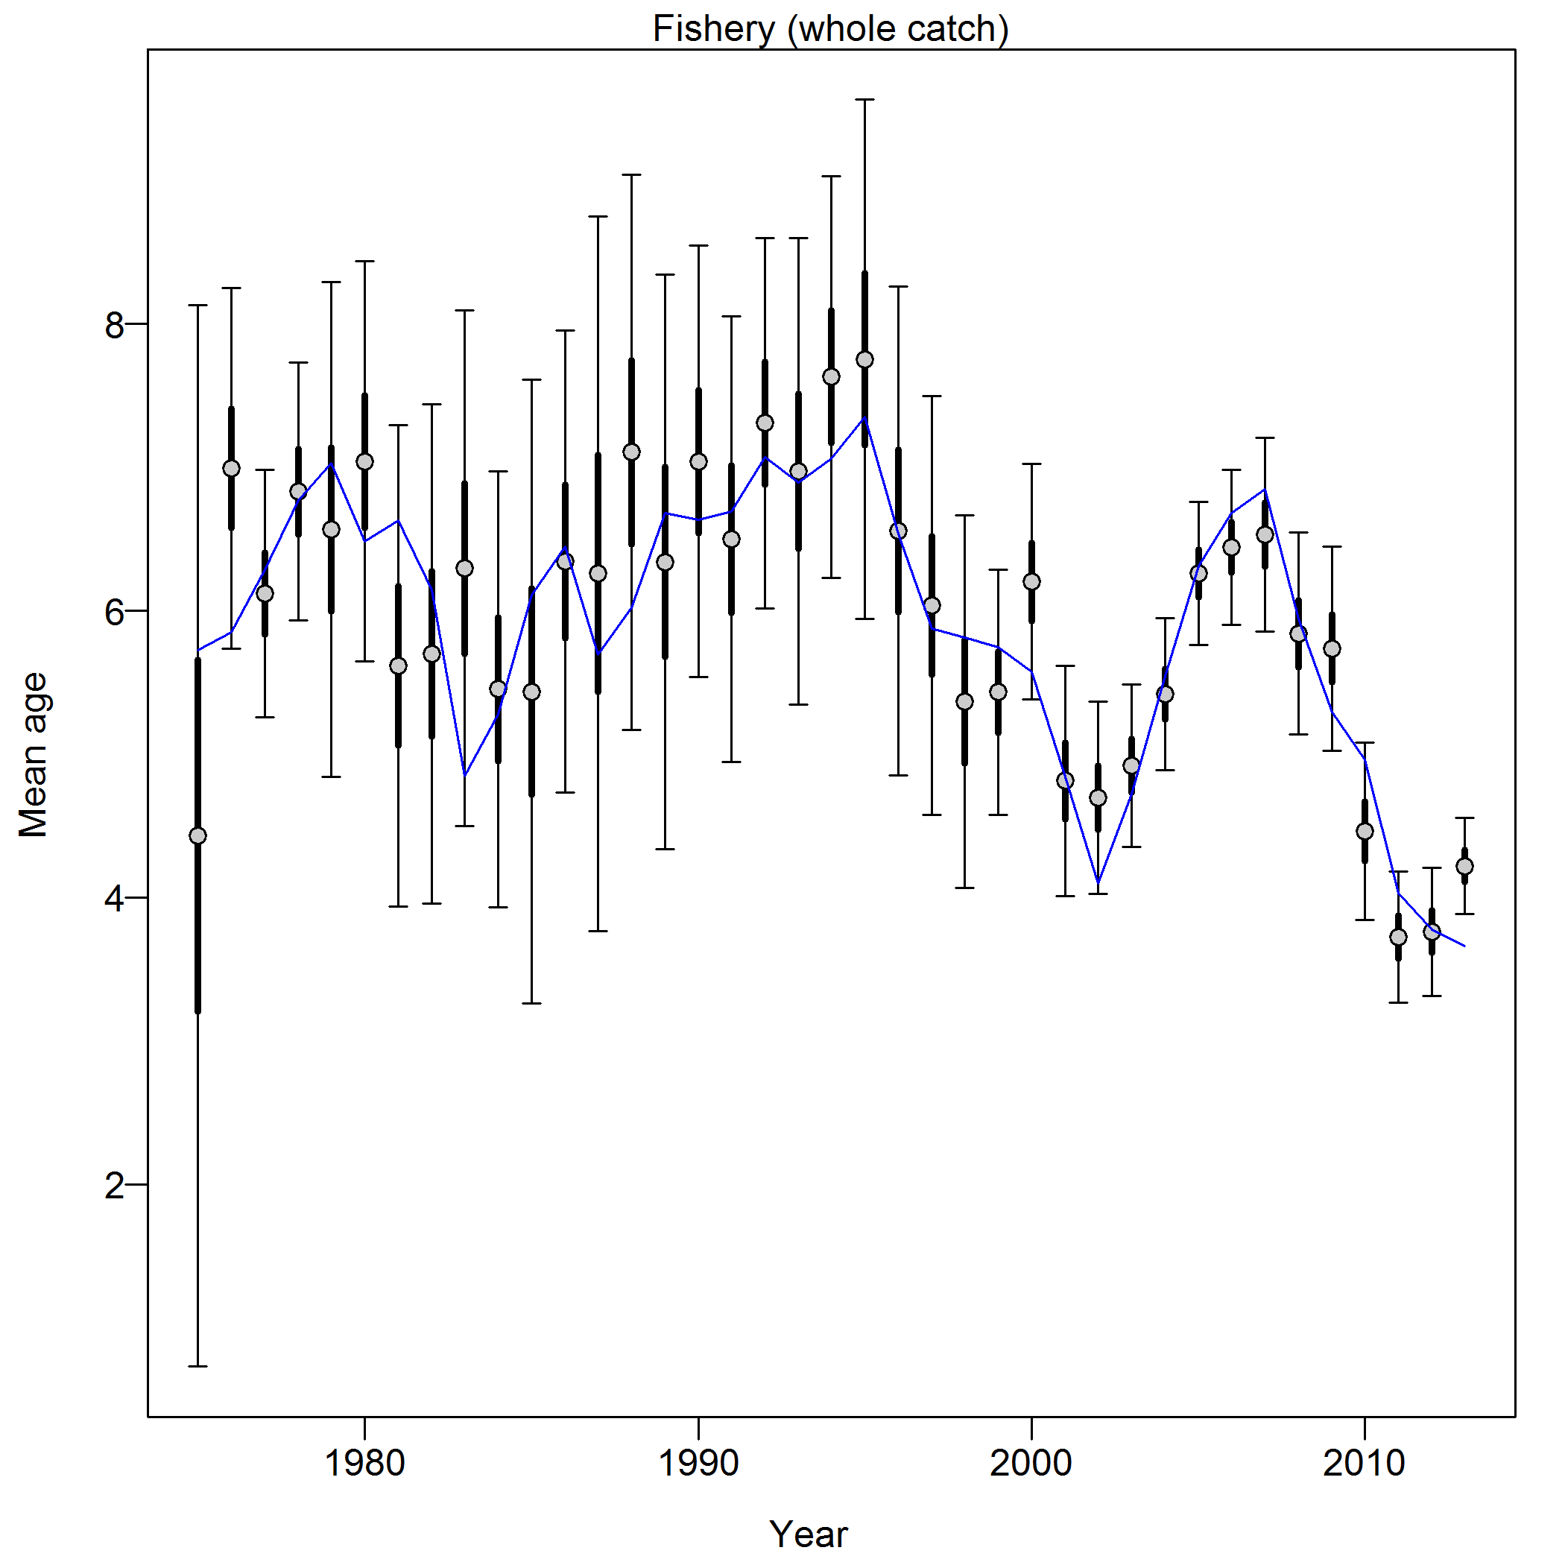
Example model: hake, SSMethod.TA1.8
"Francis Weights - age: Fishery: 0.1098 (0.0717-0.2155)"
Thick intervals: expected variability in mean from current sample sizes
Thin intervals: expected variability in mean from alternative sample sizes
source model: hake2014_simplified

Slide 35
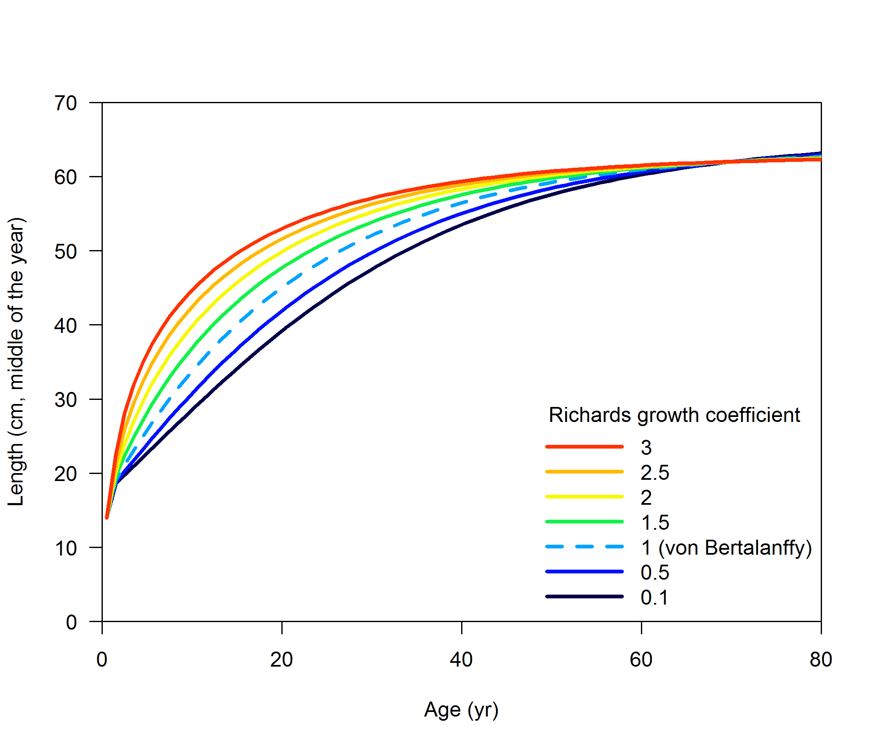
Alternatives to von Bertalanffy: Schnute/Richards
2 # GrowthModel: 1=vonBert with L1&L2; 2=Richards with L1&L2; 3=age_speciific_K; 4=not implemented

Slide 36
Alternatives to von Bertalanffy: age-specific k
3 # GrowthModel: 1=vonBert with L1&L2; 2=Richards with L1&L2; 3=age_speciific_K; 4=not implemented

Slide 37
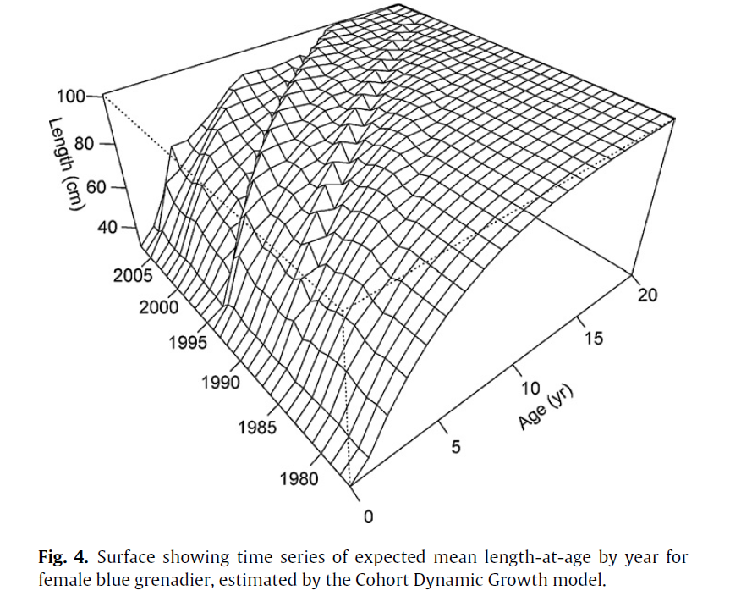
Time-varying growth
Ask Athol Whitten
More on this at 8am on Friday
source: Whitten et al. (2013)

Slide 38
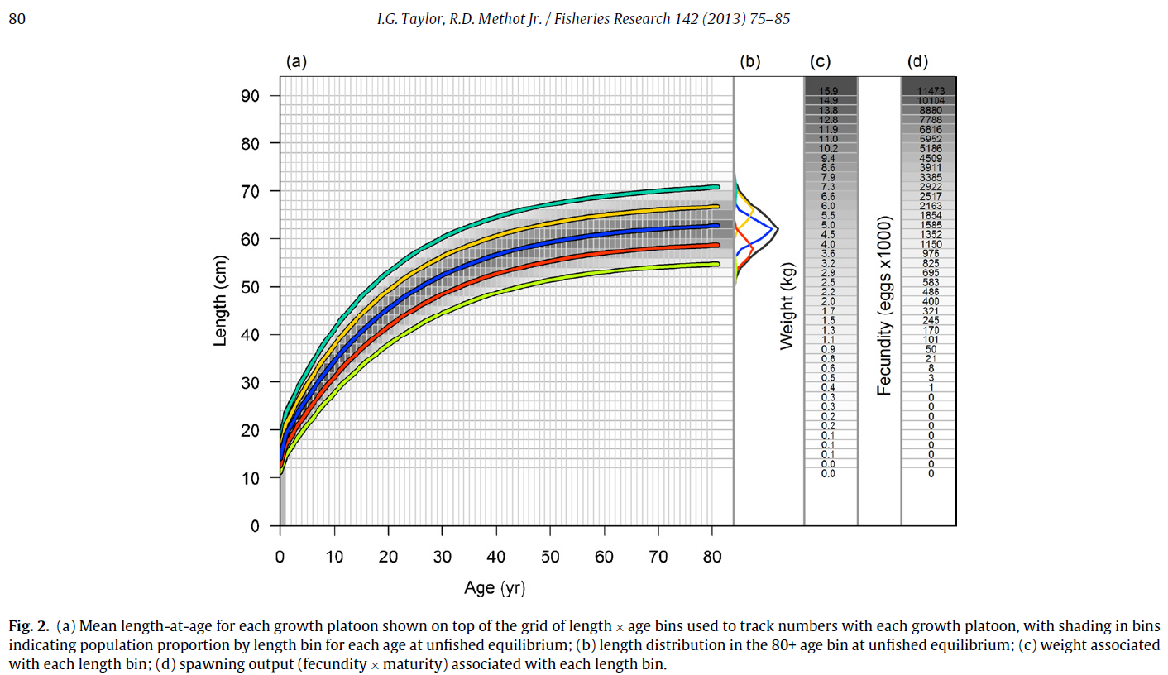
Growth platoons
1 #_N_Growth_Patterns
5 #_N_Morphs_Within_GrowthPattern
1 #_Morph_between/within_stdev_ratio (no read if N_morphs=1)
-1 1 1 1 1 #vector_Morphdist_(-1_in_first_val_gives_normal_approx)

